Slide 1
Airport College International eLearning for Airlines, Ground Handling and Catering Ground Handling Training in Korea and Japan GHI Asia 2026, Suntec Convention Centre, Singapore Pertti Mero
31 March 2026

Slide 2
Digital Training Solutions in Korea and Japan
Insights from working with ground handling partners in Korea and Japan
Pertti Mero
CEO and Founding Partner
Airport College International Ltd.
Helsinki Airport, Finland
www.airportcollege.com
eLearning for Airlines, Ground Handling and Catering
IATA Strategic Partner | Member of Airport Services Association
BANGKOK | BUENOS AIRES | DUBAI | HELSINKI | HONG KONG | LOS ANGELES | MANILA | SEOUL | SINGAPORE | ST. LUCIA | TOKYO

Slide 3
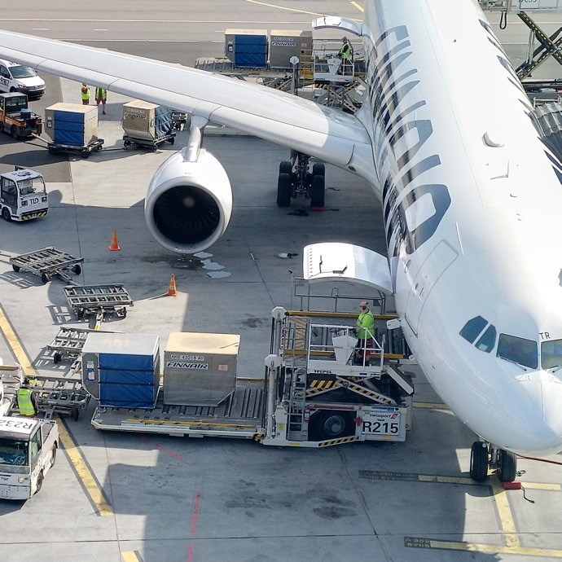
Airport College International
What We Do
Aviation in Japan and Korea
Ground Handling Challenges
What We Have Learned
Key Takeaway
Q&A
Contact Information
BANGKOK | BUENOS AIRES | DUBAI | HELSINKI | HONG KONG | LOS ANGELES | MANILA | SEOUL | SINGAPORE | ST. LUCIA | TOKYO

Slide 4

What We Do

Slide 5


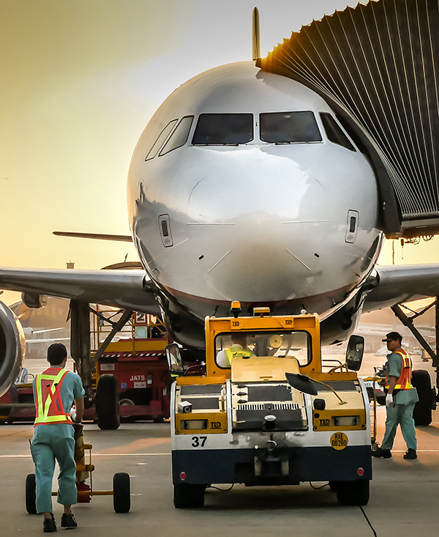
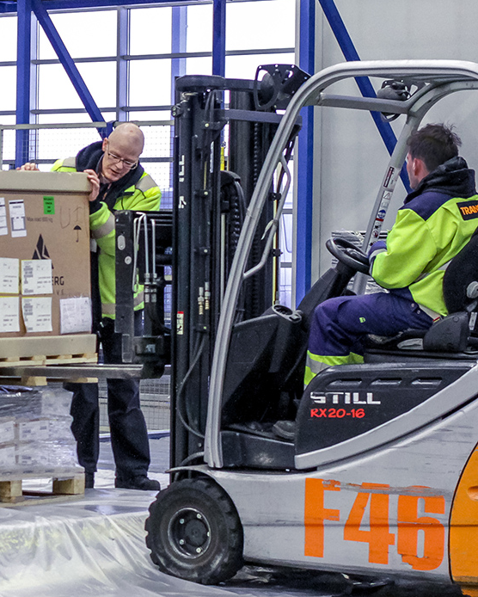

Online Training for Airlines, Ground Handling and Catering
Passenger Service
Ramp Handling
Air Cargo
Catering
BANGKOK | BUENOS AIRES | DUBAI | HELSINKI | HONG KONG | LOS ANGELES | MANILA | SEOUL | SINGAPORE | ST. LUCIA | TOKYO

Slide 6
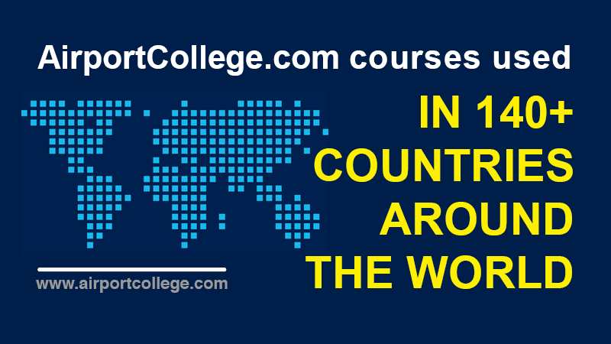

Slide 7
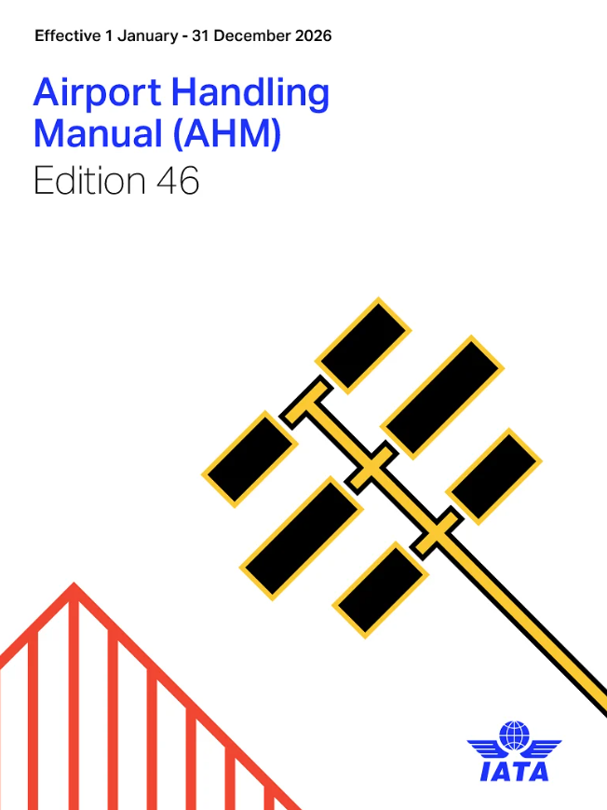
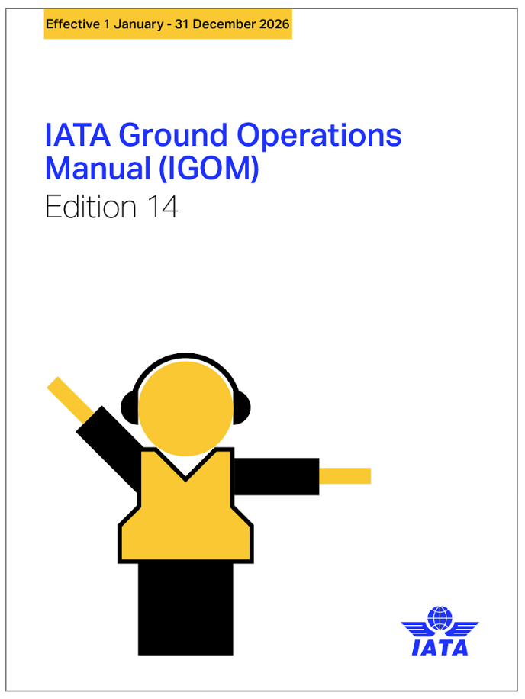
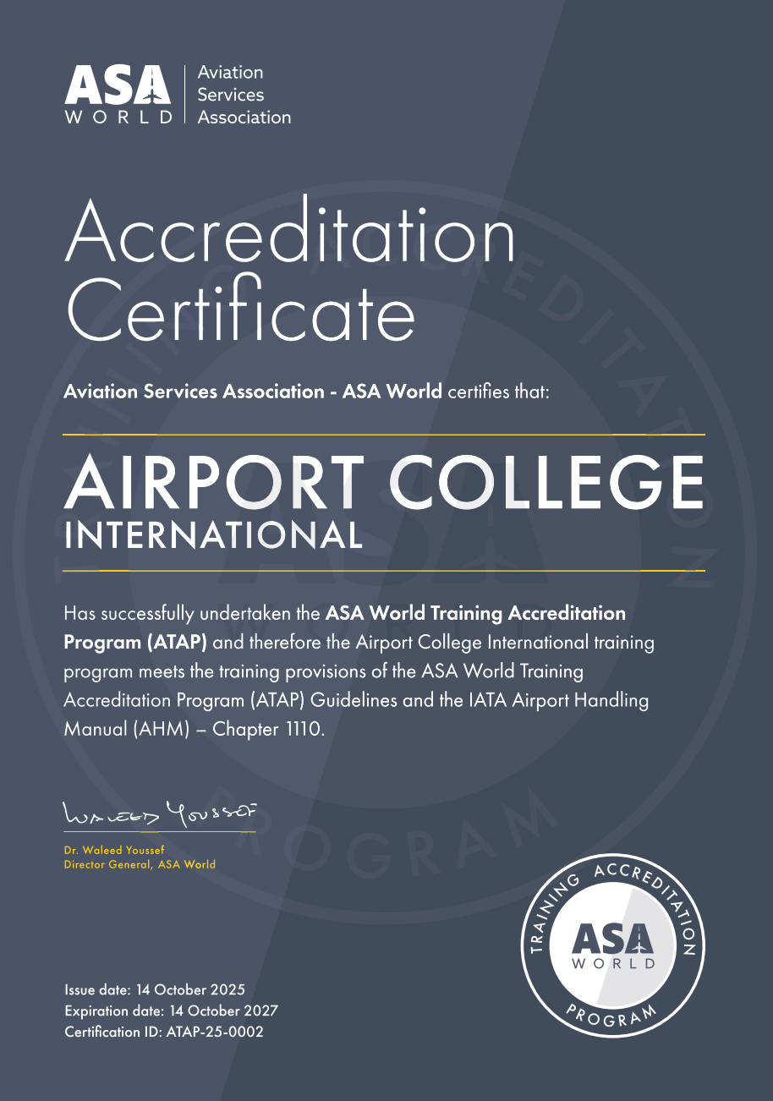
International Training Standards
AHM 1110: Ground Operations Training Program
BANGKOK | BUENOS AIRES | DUBAI | HELSINKI | HONG KONG | LOS ANGELES | MANILA | SEOUL | SINGAPORE | ST. LUCIA | TOKYO

Slide 8
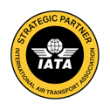




Our Global Partnerships
IATA Strategic Partner
Member of Airport Services Association (ASA)
Cooperation with ULD CARE
Airport Ground Handling Association Japan
Co-operation with Menzies CNAC Aviation Academy
BANGKOK | BUENOS AIRES | DUBAI | HELSINKI | HONG KONG | LOS ANGELES | MANILA | SEOUL | SINGAPORE | ST. LUCIA | TOKYO

Slide 9
Aviation in Japan and Korea

Slide 10

Aviation in Japan and Korea
Two Key Aviation Markets
Major hubs for passenger & cargo traffic
Gateways between Asia, Europe and North America
High operational and safety standards
Strong Growth Drivers
Rapid traffic recovery
Government tourism targets
Japan: 60M visitors by 2030
Korea: 30M visitors by 2030

Slide 11


South Korea - Aviation Market Overview
Growth & Strategy
Traffic ~20% above 2019 levels
~18M visitors annually
Target: 30M visitors by 2030
Incheon strengthening as global hub
Industry Transformation
Korean Air - Asiana merger
Network expansion & consolidation
Cargo & Fleet
Strong electronics & semiconductor cargo hub
Major Asia Pacific air cargo hub

Slide 12


Japan – Aviation Market Overview
Tourism Growth
~42M visitors annually
Target: 60M by 2030
Government Actions
Airport expansion (Haneda, Narita, Kansai)
Regional tourism promotion
Airline & Cargo
Increased international routes
Strong cargo demand (electronics, pharma)
Challenges
Congestion and Workforce shortages

Slide 13
Ground Handling Challenges

Slide 14
The Workforce Gap
Traffic vs Workforce
The Result
⬆ Passenger & Cargo traffic
⬆ Aircraft movements
⬆ Visitors
⬇ Workforce availability
⬇ Training capacity
Faster onboarding needed
Pressure on safety & performance
Increasing operational complexity

Slide 15
How Ground Handlers Respond?
Key Actions
👥 More Foreign Workers (Japan)
💻Digital training adoption
📘Standardised training programmes
🌍Multilingual workforce training
🔄Blended learning approach (digital, classroom and OJT)

Slide 16
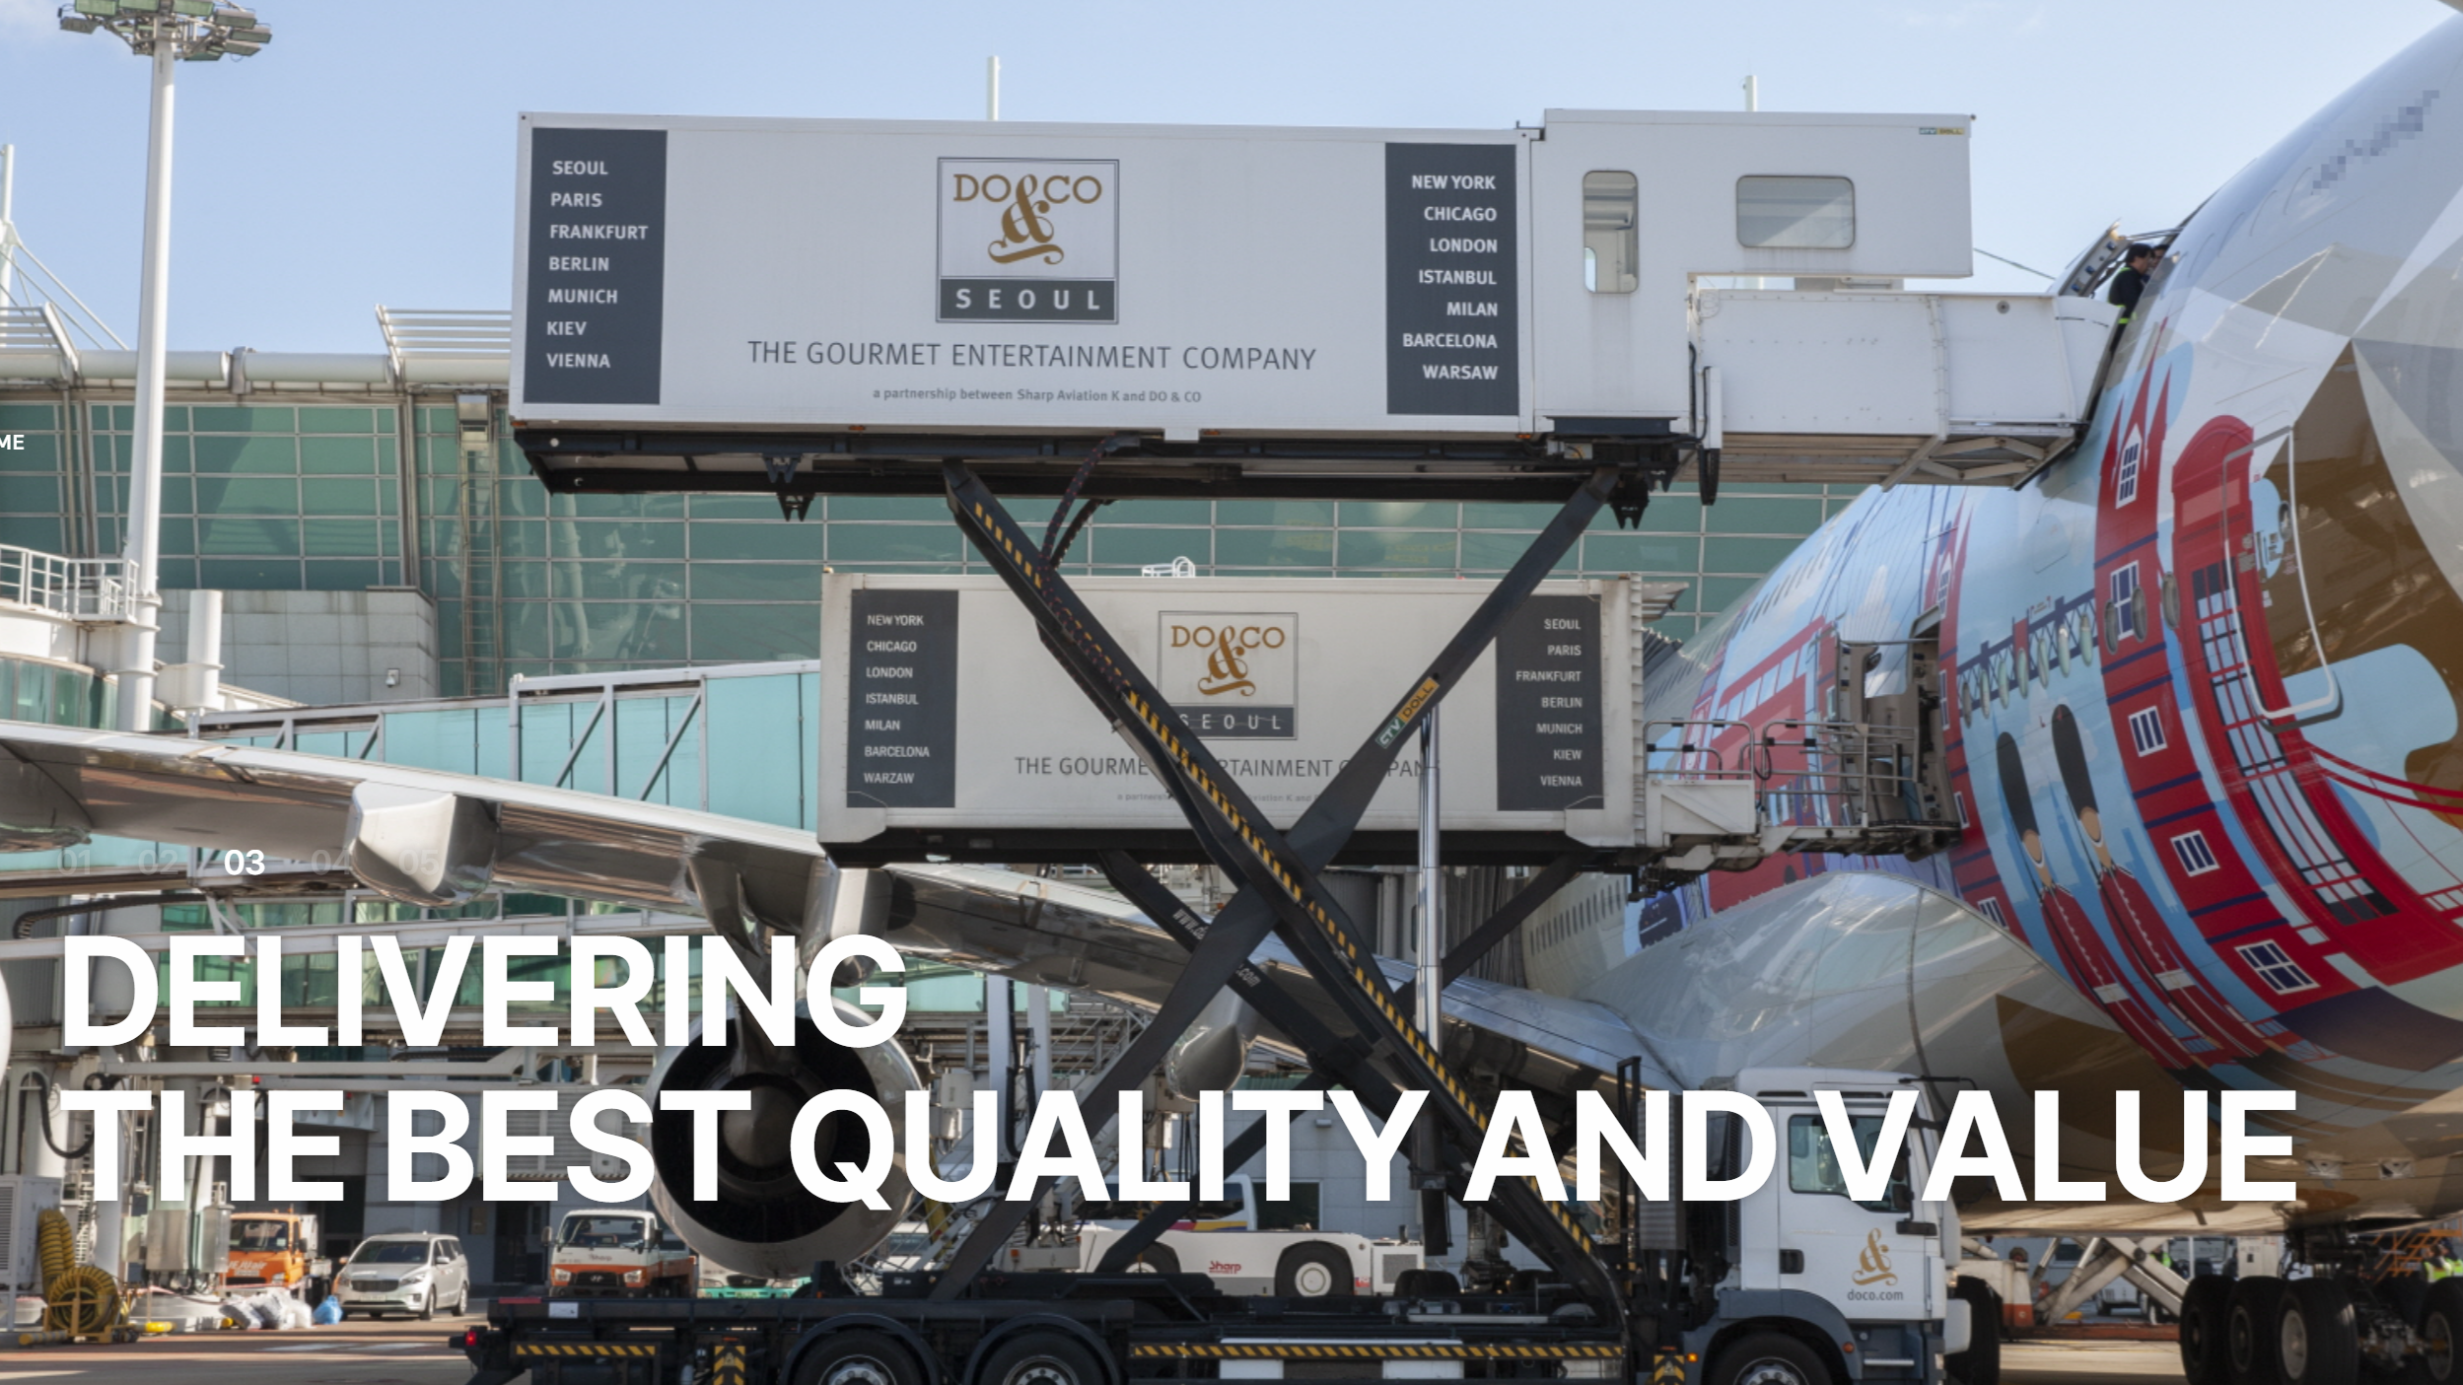
South Korea Case - Sharp Aviation K

Slide 17
South Korea Case - Sharp Aviation K
Challenge
Solution
One-stop-service
Rapid growth
Large workforce
8 Airports in Korea
Blended training + eLearning
Multilingual (KR and EN)
IATA AHM 1110 aligned
Result
70,000 eLearning certificates
Entire workforce
Faster onboarding
Cost efficiency

Slide 18
Japan Case: Ground Handling Company 1000+ employees
Challenge
Solution
Workforce shortage
20% non-Japanese staff
Training in Japanese, English, Korean & Chinese
IATA AHM 1110 aligned
Result
5,000+ eLearning certificates
Faster onboarding
Consistent standards

Slide 19
What We Learned

Slide 20
What We Learned
Key Insights
Growth returns faster than workforce capacity
Labour shortage is the biggest risk
Training must scale quickly
Efficiency on the ground is critical

Slide 21
Closing
“Traffic can grow quickly.
The workforce must be ready to support it.”
BANGKOK | BUENOS AIRES | DUBAI | HELSINKI | HONG KONG | LOS ANGELES | MANILA | SEOUL | SINGAPORE | ST. LUCIA | TOKYO

Slide 22
Q&A

Slide 23
Q&A
Feel free…
BANGKOK | BUENOS AIRES | DUBAI | HELSINKI | HONG KONG | LOS ANGELES | MANILA | SEOUL | SINGAPORE | ST. LUCIA | TOKYO

Slide 24
Contact Information

Slide 25
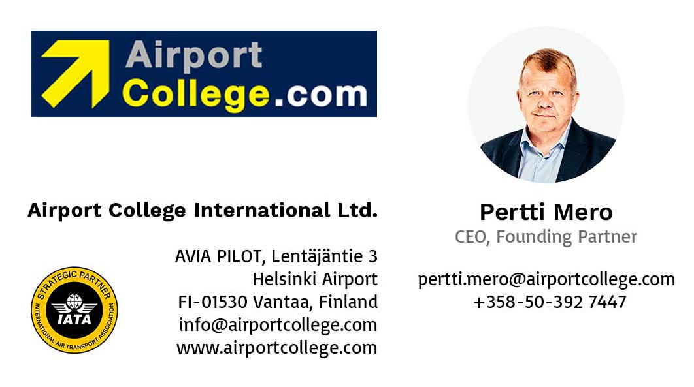
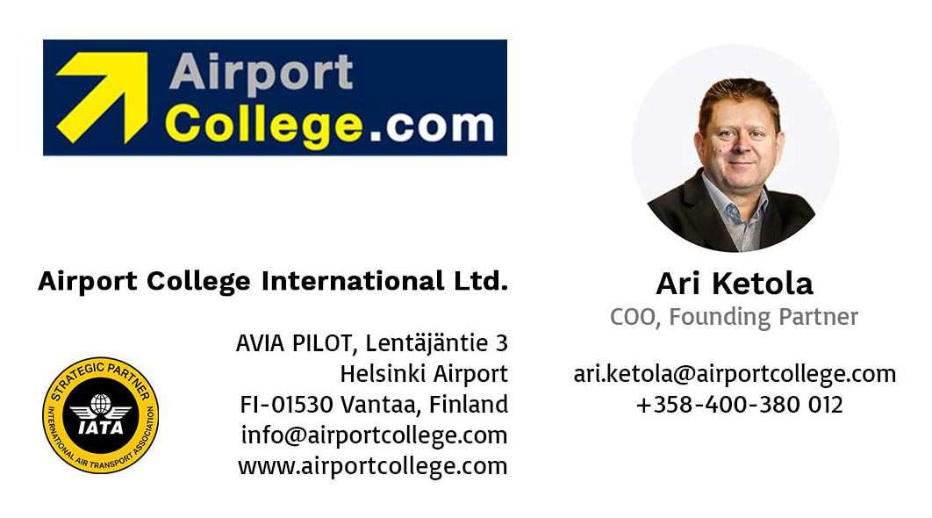
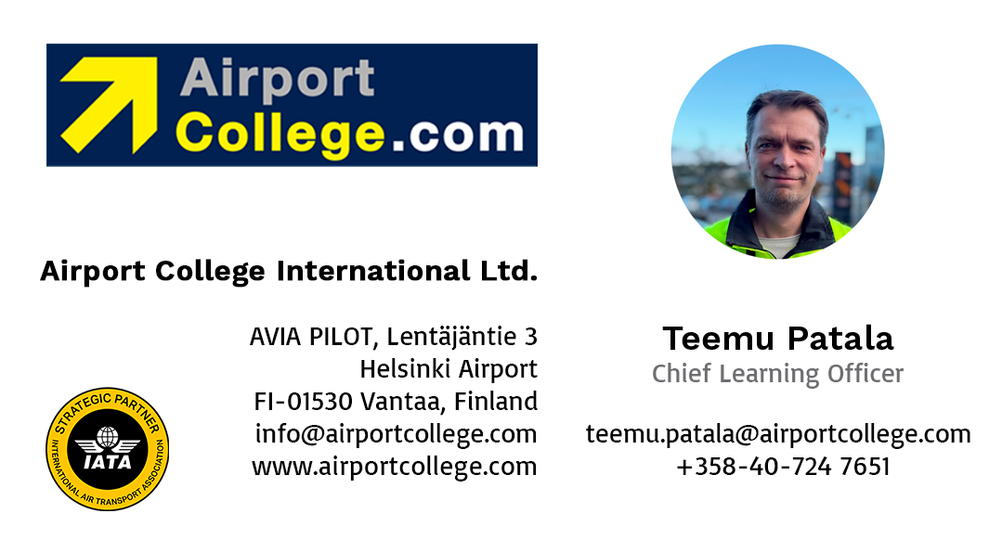
Contact Information
BANGKOK | BUENOS AIRES | DUBAI | HELSINKI | HONG KONG | LOS ANGELES | MANILA | SEOUL | SINGAPORE | ST. LUCIA | TOKYO

Slide 26
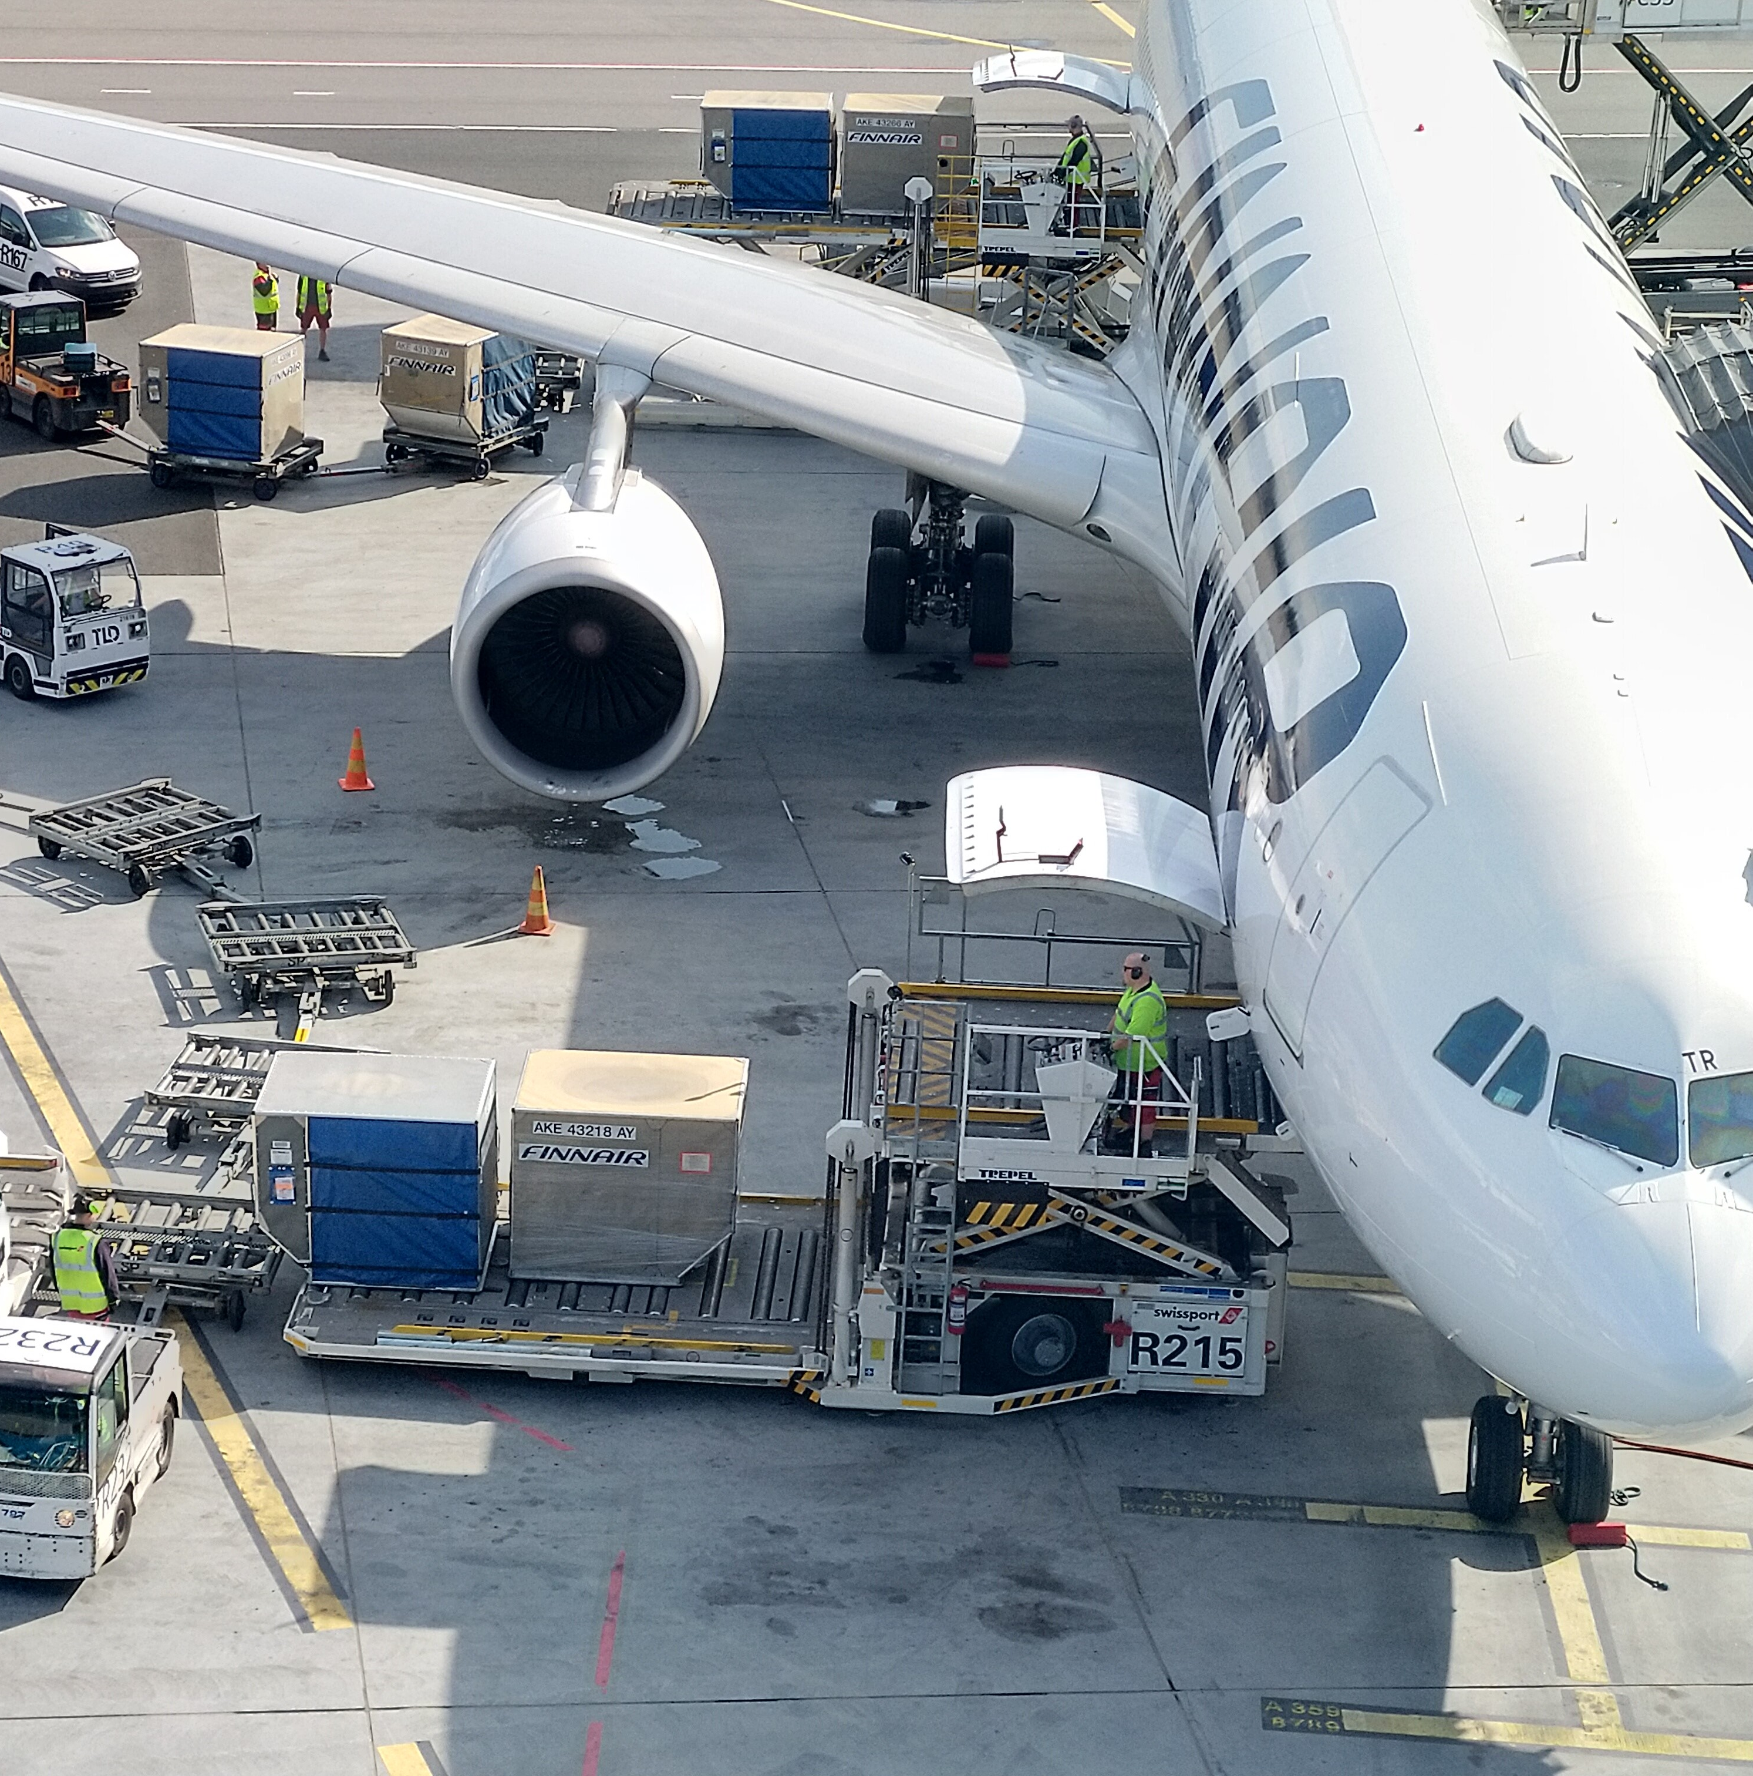
AIRPORT COLLEGE INTERNATIONAL LTD.
Airport College offers a comprehensive portfolio of online eLearning training courses covering aviation safety, security and service topics. Courses vary in length from 1 to 3 hours, with the primary objective of maintaining the competence of operational staff. To ensure regulatory compliance, course contents are based on international training standards set by governing bodies such as ICAO, FAA, EASA and IATA.
COMPETITIVE ADVANTAGE
We have over 50 ready-to-use online eLearning courses available worldwide 24/7 in many languages including English, Japanese, Korean, Chinese, Finnish, French, Thai, Spanish and more to come. We work with the leading experts in the aviation industry to ensure that the training content is relevant and always up to date. Our eLearning courses can be used for self-study, as part of a blended learning environment or to support instructors in the classroom. The AirportCollege.com training service reduces the various costs typically associated with classroom training, with the potential to significantly reduce training related costs by up to 80%.
IDEAL CLIENT
Our ideal clients are aviation and logistics companies or organisations that want to take advantage of the benefits of digital training for their employee development. Our clients understand the value of their employees' operational skills as the foundation for successful business and safe operations.
COMPANY
Airport College International Ltd, based in Helsinki, is an independent company with a creative approach to your training and employee engagement management. Our services are used in more than 140 countries, and we are represented through our partner network in more than 20 countries in the Americas, Europe, the Middle East, Africa, Asia and the Pacific.
BANGKOK | BUENOS AIRES | DUBAI | HELSINKI | HONG KONG | LOS ANGELES | MANILA | SEOUL | SINGAPORE | ST. LUCIA | TOKYO

