Slide 1
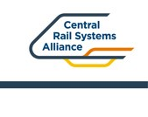
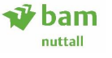
Leeds Area Improvement Programme
LAIP2
BRADFORD FORSTER SQUARE
All Hands Call
June 2025

Slide 2
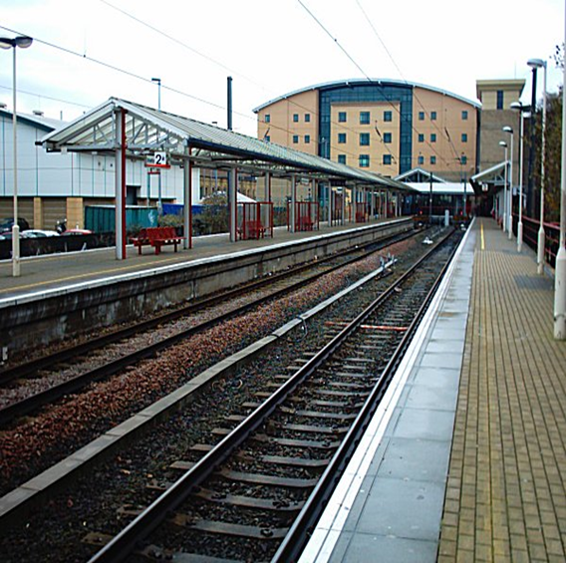
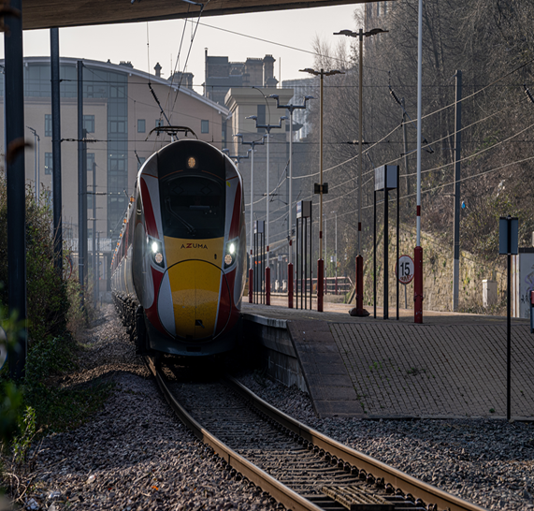
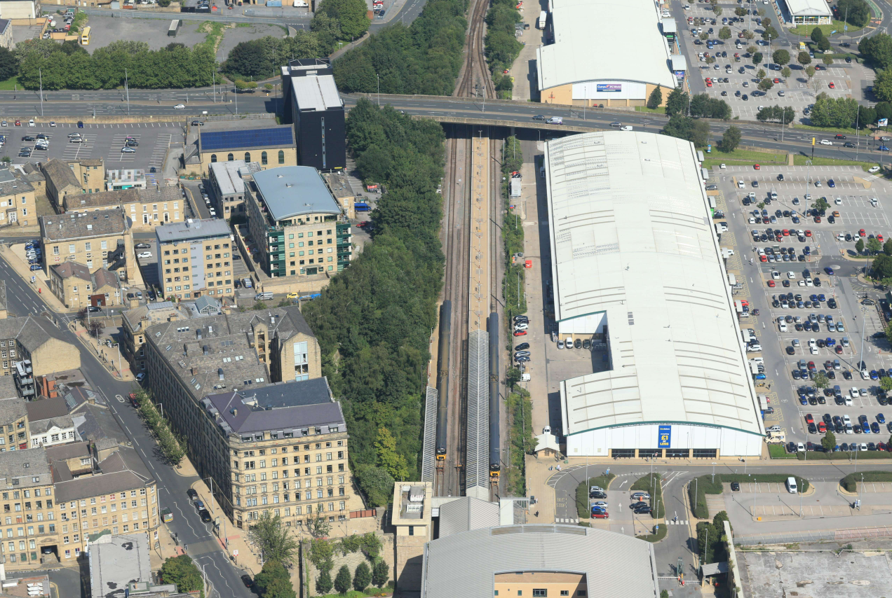
Introduction to Leeds Area Improvement Programme - Package 2
What is LAIP?
The Leeds Area Improvement Programme consists of multiple packages of enhancements in West Yorkshire that aims to improve current operational constraints within the region. The Programme will transform journeys today and create the readiness for the forecast growth of tomorrow by improving railway infrastructure.
LAIP 2 - Key Project Aim
To support the introduction of the Train Operator / DfT franchise commitments extending the London King Cross - Leeds service to Bradford Forster Square.
Infrastructure ready January 2025 to align with Bradford City of Culture 2025 and May 2025 Timetable change.

Slide 3




What are we doing and why?
Scope of Works:
New Platform 0 at Bradford Forster Square including associated track work, Overhead Line Equipment (OLE) and signalling.
Replace OLE head spans to new twin track cantilever OLE structures throughout the whole station.
Remove track cross-over (5128) and install new cross over to support increase in operational capacity and capability.
New platform 0 roof canopy, passenger furniture, information screens, CCTV and lighting.
Land acquisition east of existing Platform 1 to enable creation of new platform 0 and diversion of existing utility company services.
Proposed new track cross over
New Platform 0: (8 car)
Existing track cross over to be removed
Platform 1: (10 car)
Platform 2: (10 car)
Bradford Forster
Square Station
Project Line Diagram
Platform 3
Increases timetable & passenger capacity. Improves connectivity and renewed demand for long distance journeys.
Enhances passenger
experience at BFS. Supports low emission rail travel, passenger and economic growth in Bradford.
LAIP supports the delivery of Trans Pennine Route Upgrade and Northern Powerhouse Rail.
Increases operational capability, capacity and reduces disruption to operations in perturbation. Improves Network resilience to provide a more reliable passenger service.

Slide 4
Design and Construction Milestones
Milestone Programme (18 months)
Start of Design | October 2023
Completion of Design | September 2024
Commencement of Enabling Works | March 2024
Mobilisation and Compound Establishment* | End of April 2024
Start of Main Construction Works* | End of June 2024
Completion of Main Construction Works* | January 2025
Entry into Service (May timetable change) | 18 May 2025

Slide 5
What needed to happen to make us successful!
Funding was obtained in stages and the FBC undertaken earlier in the project life cycle but with greater risk that was unilaterally understood and accepted.
Contract awards – Separate ECI’s & Enabling Works awarded to get the project moving and hit the ground running.
Changed the design to an ES4/5 for early works to achieve timescales and programme.
Overlapping design phases and delivery activities.
Specialist contract to manage utility diversions to realise significant reduction to overall programme.
Utilised existing TRU engineering access in the plan. Compressed programme to meet Section 7 possession dates.
Ops and Northern Railways support with stabling of trains and timely taking of possessions.
Maintenance support through the Asset Management Plan (AMP) process.
Supply chain (BAM / CRSA / Volker Rail) very proactive working together to achieve collective goals.
Project supported by Bradford City council, DfT, British Land and local business.
Route Engineers and support functions pragmatic approach and timely review / acceptance of design and TQ’s.
Early proactive engagement by BAM / NR with ORR & System Review Panel (SRP) during the Authorisation to Place In Service (APIS) and Entry into Service (EiS) processes.

Slide 6
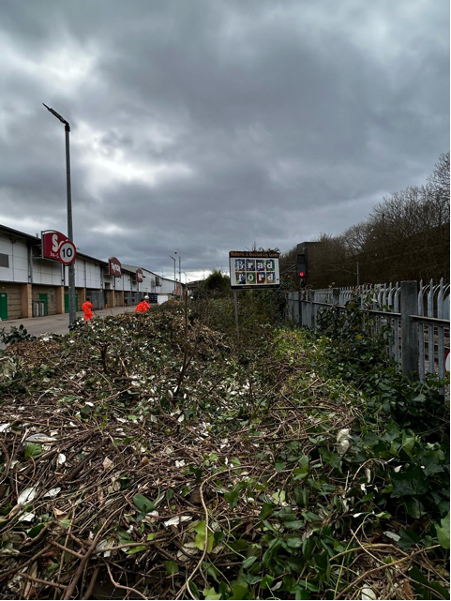
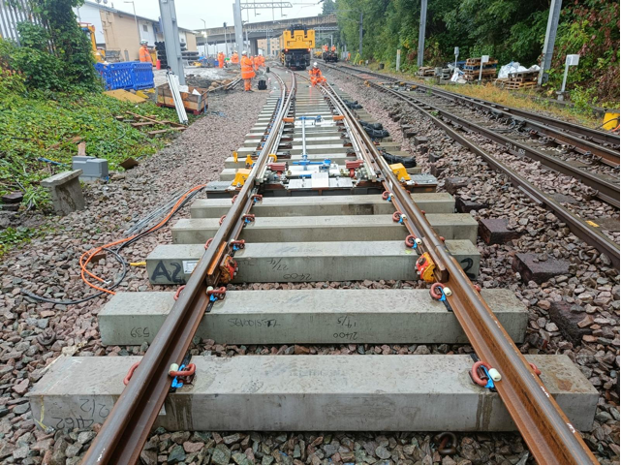
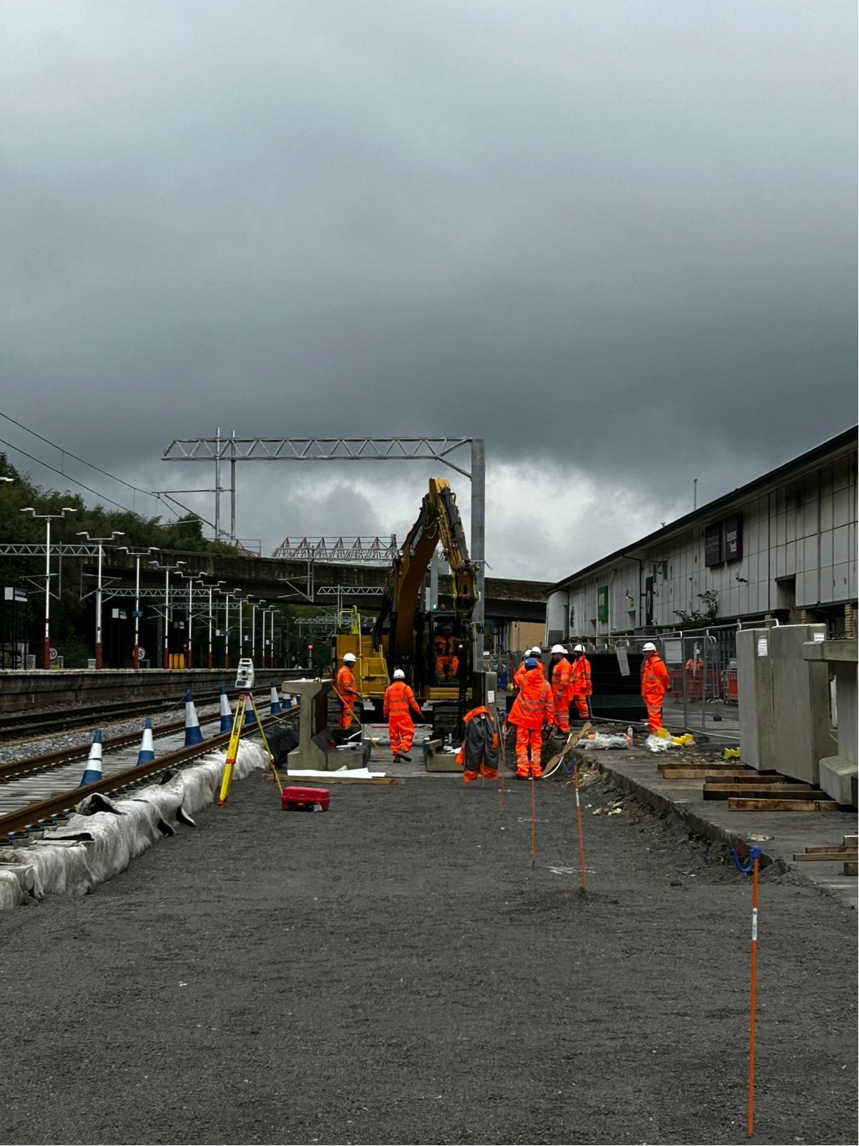
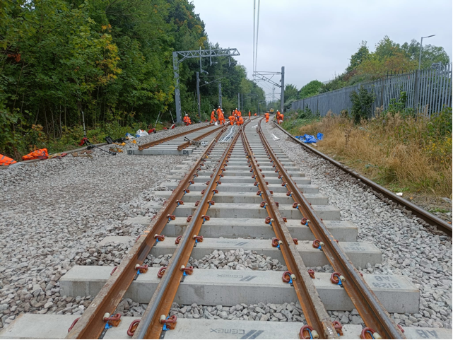
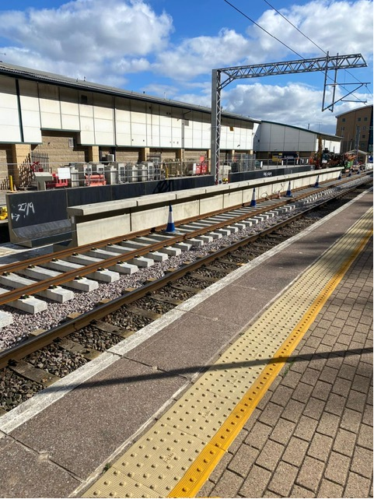
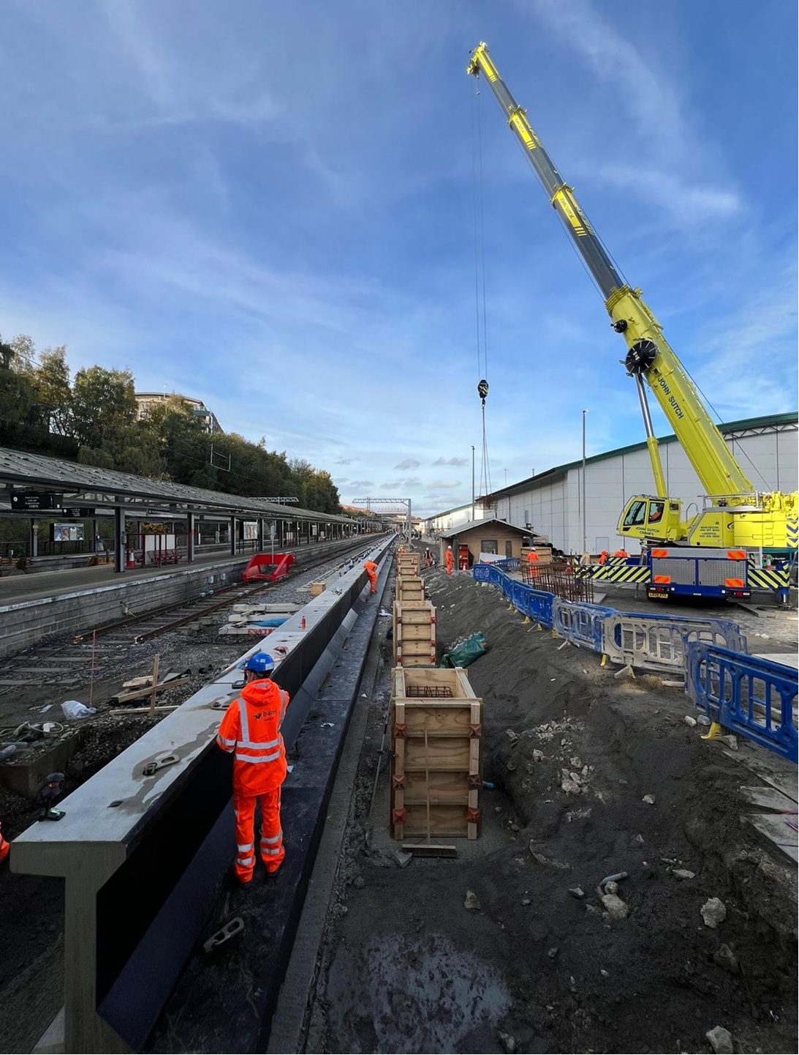
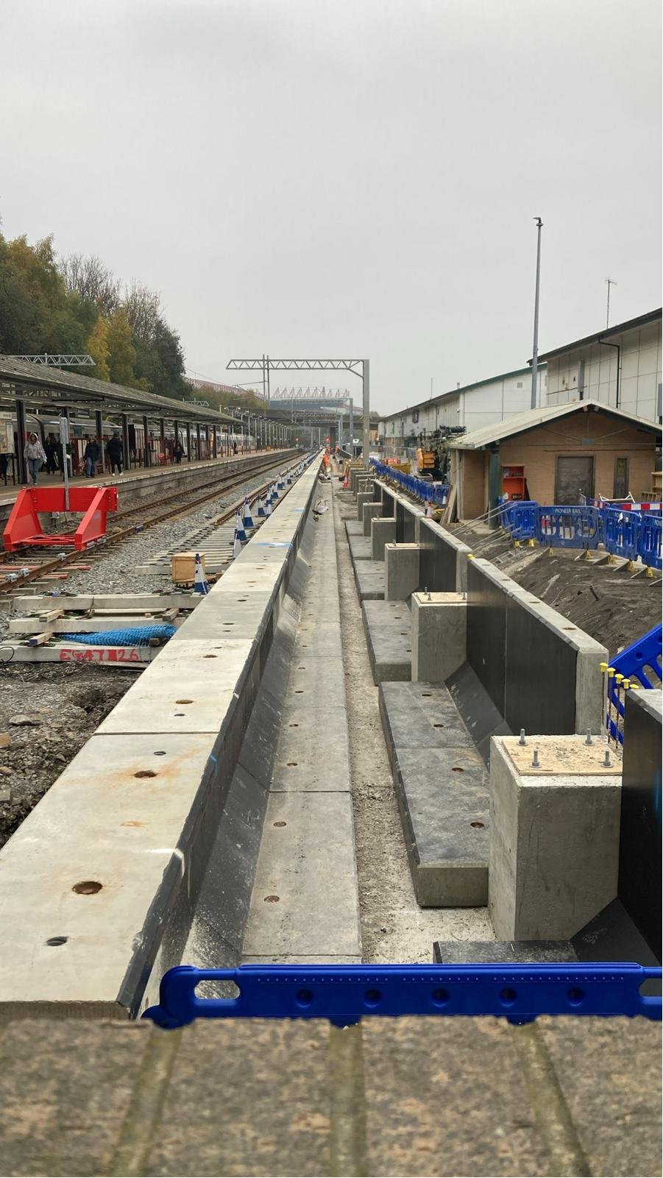
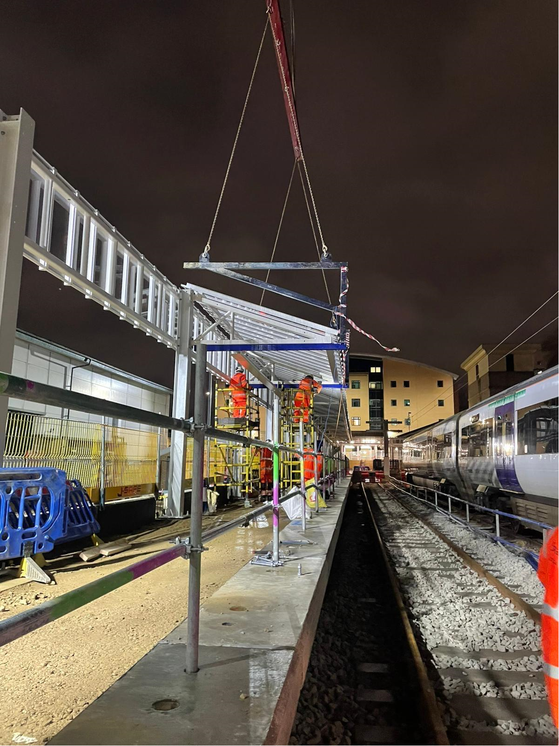
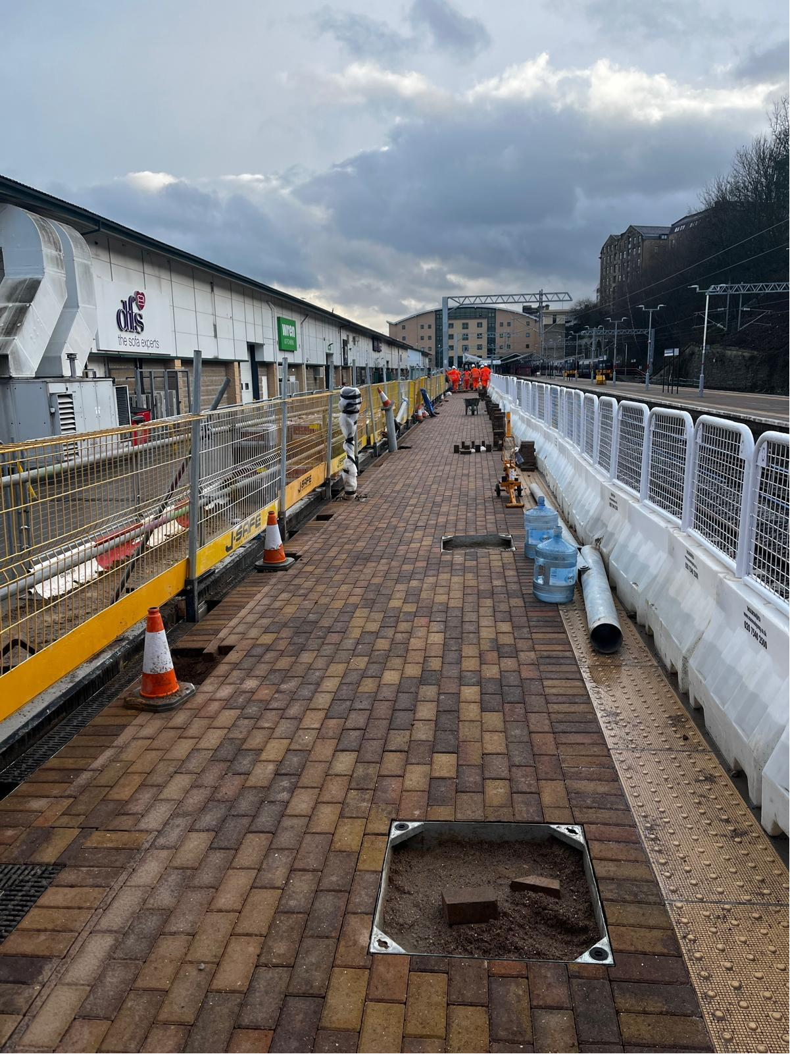
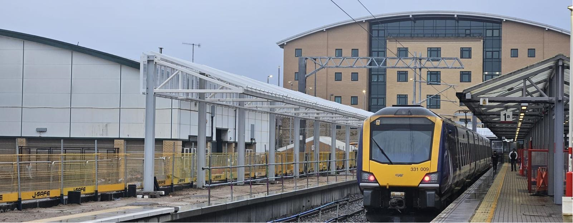
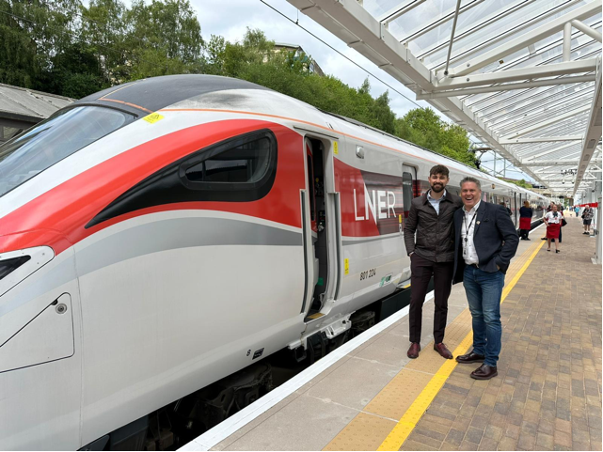
Progress Photos

Slide 7
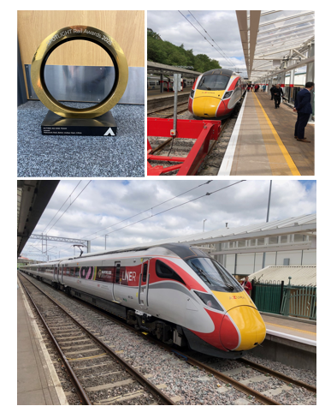
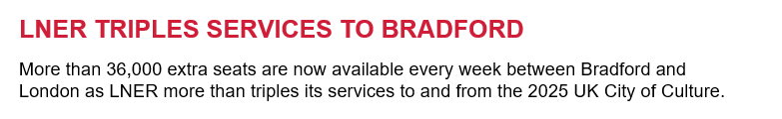
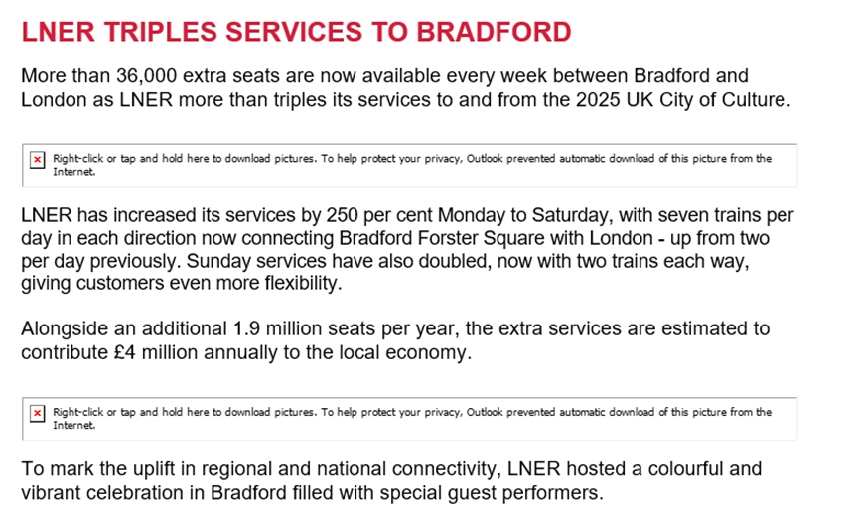
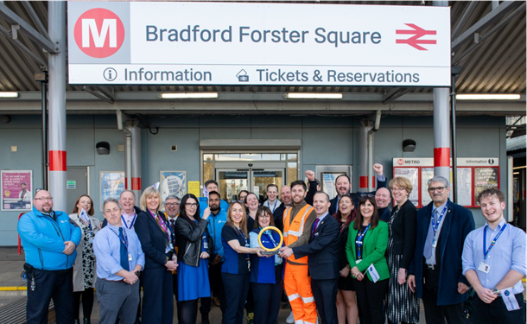
The Benefits and Outcomes

