Slide 1
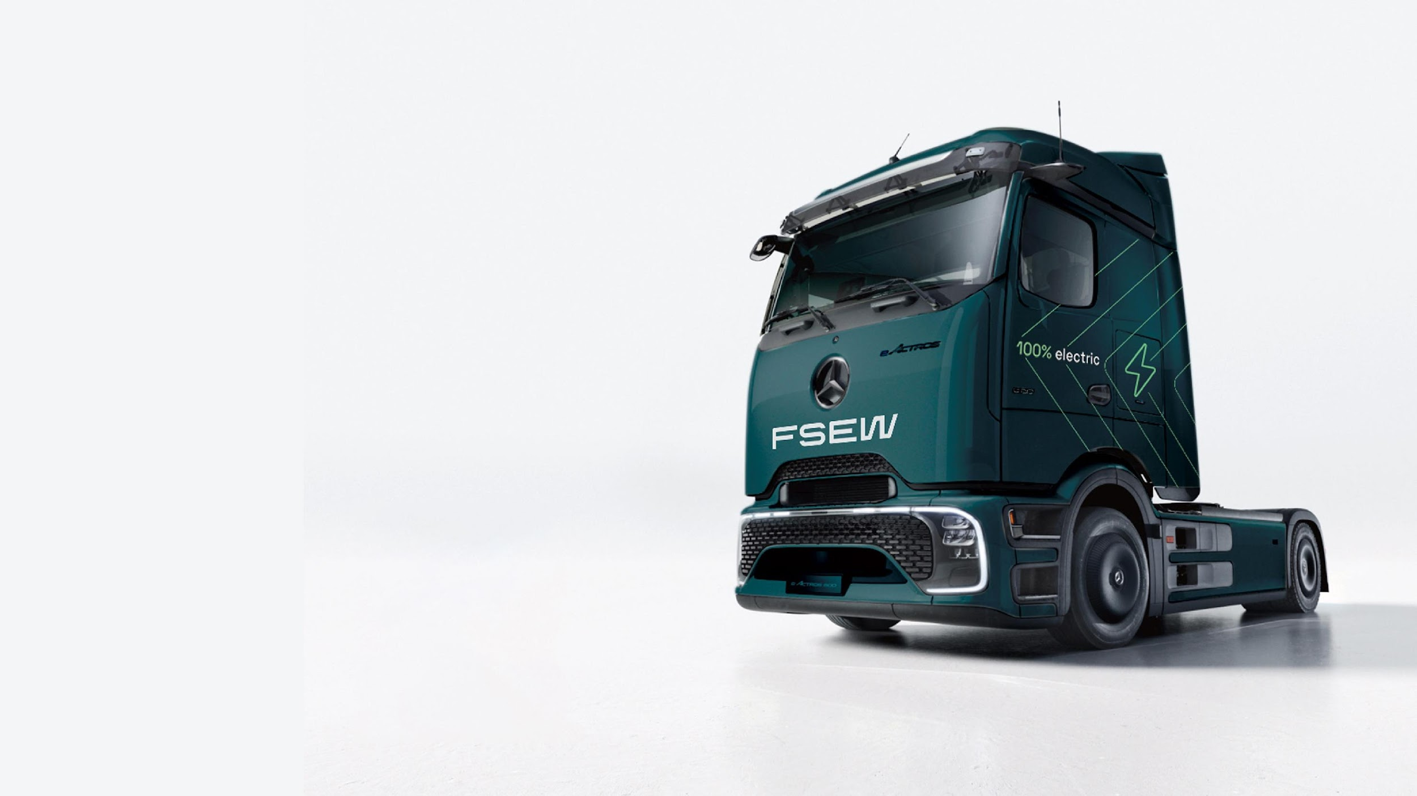


FSEW: The freight decarbonisation specialists
Motor Transport
Decarbonisation Summit 2025 by:
Geoff Tomlinson, MD, FSEW
24/09/2025

Slide 2





Who are FSEW?
The UK’s first fully diesel-free Freight Forwarder
Founded in July 2002
Integrated worldwide freight forwarder with our own fleet of trucks
Wide range of SME and blue-chip customers
First in the UK, to launch fully electric heavy freight trucks
Fleet Composition – 100% Biomethane CNG trucks, eHGVs & LSTs

Slide 3
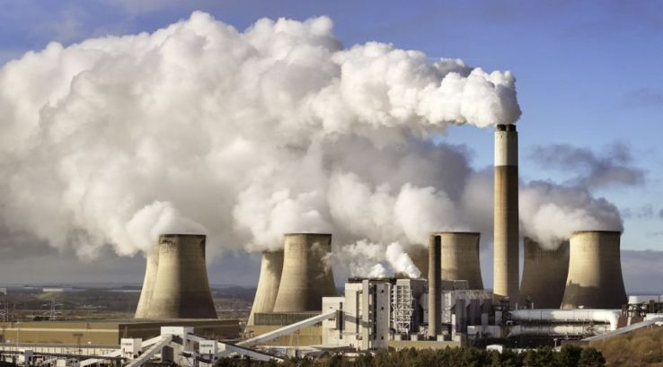
Why freight decarbonisation?
Why clean transport matters?
The challenge:
“Cardiff’s global warning”
Capital named UK city most at risk from climate change in worrying new report.

Slide 4






Our journey so far
2017
2017
2022
2023
The electric truck journey begins
FSEW team
reactions
First in the UK to launch fully electric heavy freight trucks
CNG (Biomethane) trucks introduced

Slide 5

Our journey so far
2023
2024
2025
ISO 14001 accreditation
Diesel-free by 2025 –
Achieved ahead of schedule
Mercedes eActros 600 Trucks

Slide 6



2025 and beyond
First international freight forwarding provider to truly offer reporting of Scope 3 emissions to our customers.
FSEW offering in-setting & carbon reporting packages to sea and air freight clients
FSEW re-brand launched Q1 2025.
Mercedes eACTROS 600 trucks 2025
FSEW e-Freight Hub planned opening in Cardiff 2026
eHGV autonomous 2027
Net-zero by 2030
Commitment to continued leadership in decarbonising freight.

Slide 7


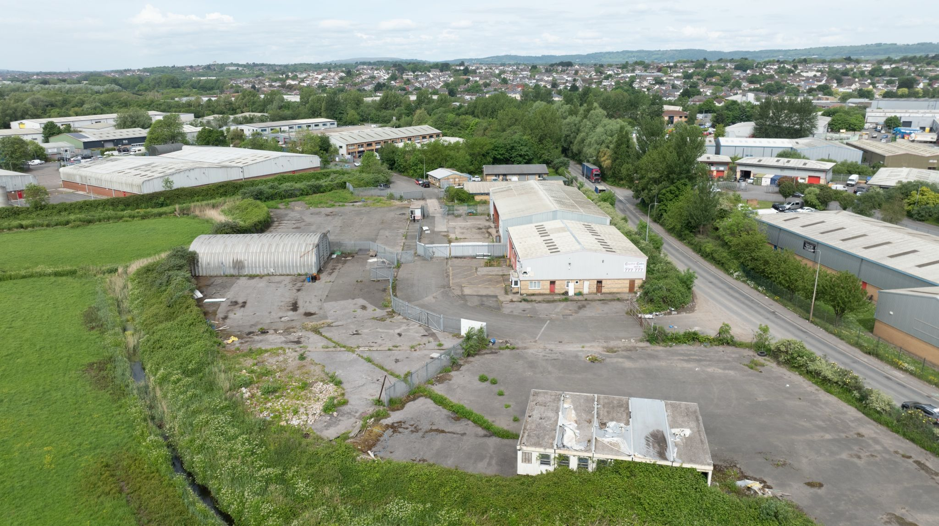


2.4acre site on one of the main industrial roads/areas in Cardiff
Cardiff,
New efreight Hub

Slide 8
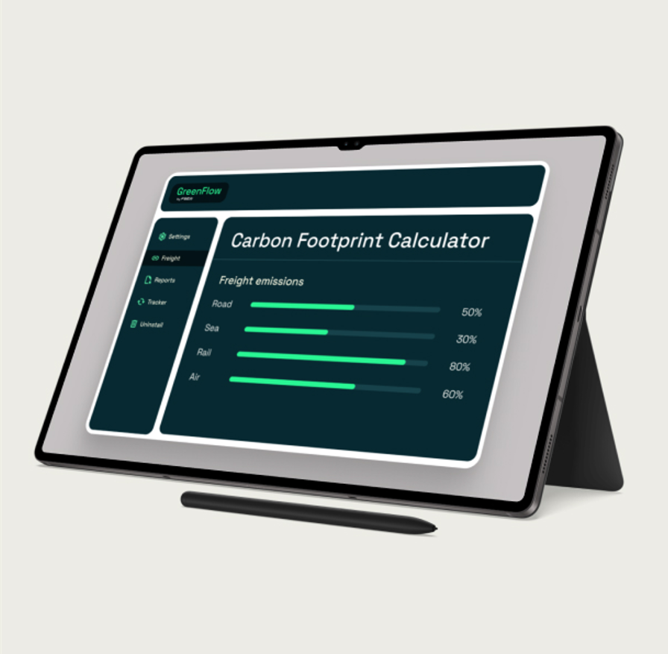


Your path to
net-zero freight
Why choose GreenFlow?
Tailored to your business
GreenFlow is best in class freight solution
that helps businesses decarbonise supply chains
by moving freight globally via road, rail, sea, and air
on a net zero basis to and from anywhere in the world.
Measurable carbon savings
Transparent reporting

Slide 9
Sustainability achievements at a glance
Delivering Measurable Impact
2,400 tonnes CO2 avoided by our fleet of ULEVs
2.4 million diesel kms avoided by our fleet of ULEVs
Reduced our Scope 1 & 2 emissions by 1,173.7 tCO2e in 2024 compared to
2023.
Comprehensive Scope 3 reporting through GreenFlow

Slide 10


What have we learnt?
Partnerships are key (customers/truck manufacturers)
Some decision makers don’t care about the climate
Transport businesses will have to change the way they finance
Decarbonising freight is a significant challenge

Slide 11
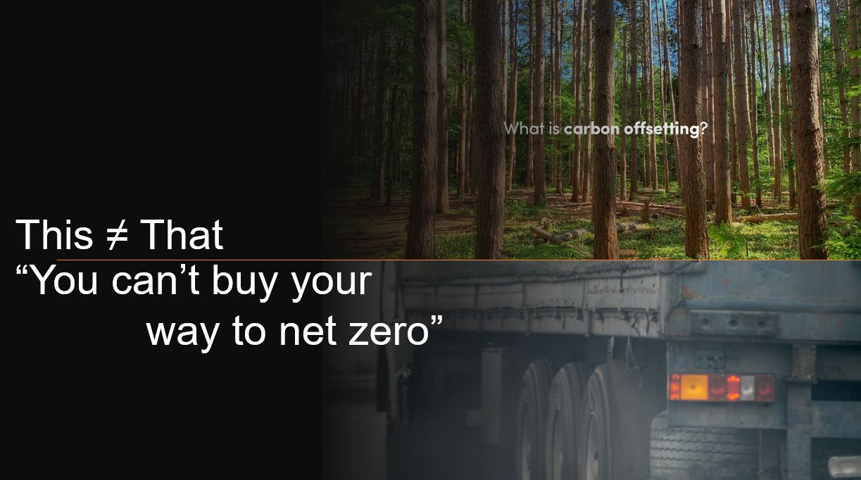


Why freight decarbonisation is difficult
It requires significant investment of time,
money and infrastructural change
Changing what already works can seem like a huge risk
Trying to change people's opinions can be difficult
Different skillsets are required (logistics/ sustainability)

Slide 12

Strategic freight decarbonisation
is the difference
Legislation is inevitable, and infrastructure will require future-proofing investment
Lack of Scope 3 accounting means missing out on commercial opportunities
Changing customer attitudes demand authentic green credentials
Successful adoption could mean retaining & expanding customer base
Failing to adapt now poses an even greater risk

Slide 13
Client Benefits : Quality of Execution
Lower Emissions in their supply chain
Compliance with tightening ESG requirements
Transparent and audited reporting for stakeholders
Scope 3 emission reduction without disrupting operations and
maintaining on time delivery
Assisting clients to achieve their own scope 3 targets ( Some companies
have internal carbon tax)

Slide 14

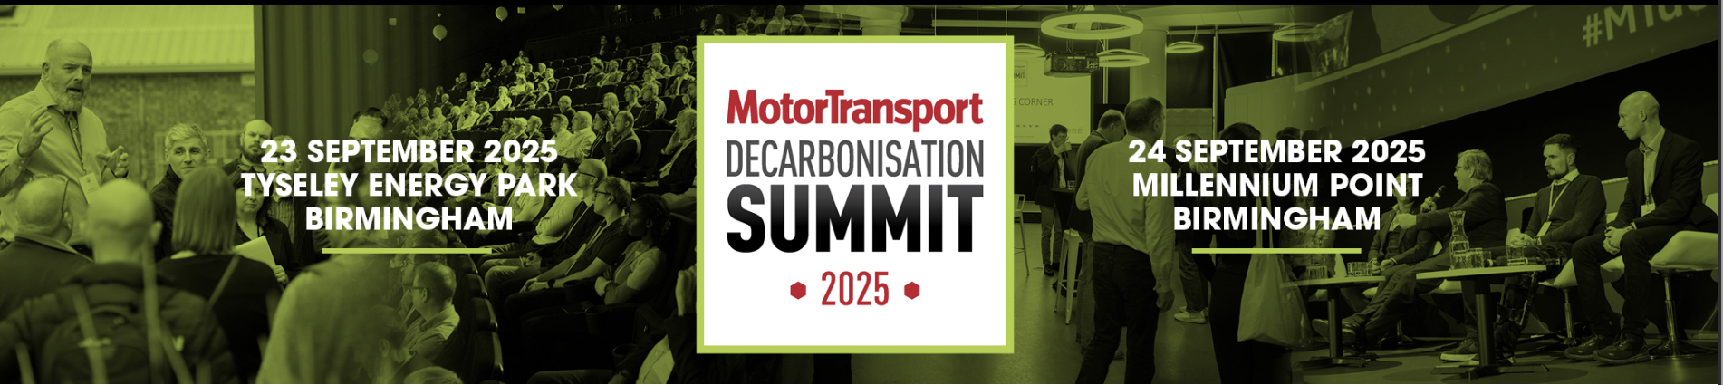

Any Questions?
Geoff Tomlinson
07814 009 191
geoff.tomlinson@fsew.com
www.fsew.com

