Slide 1
LNG Supply to Logistics Fleet

Slide 2
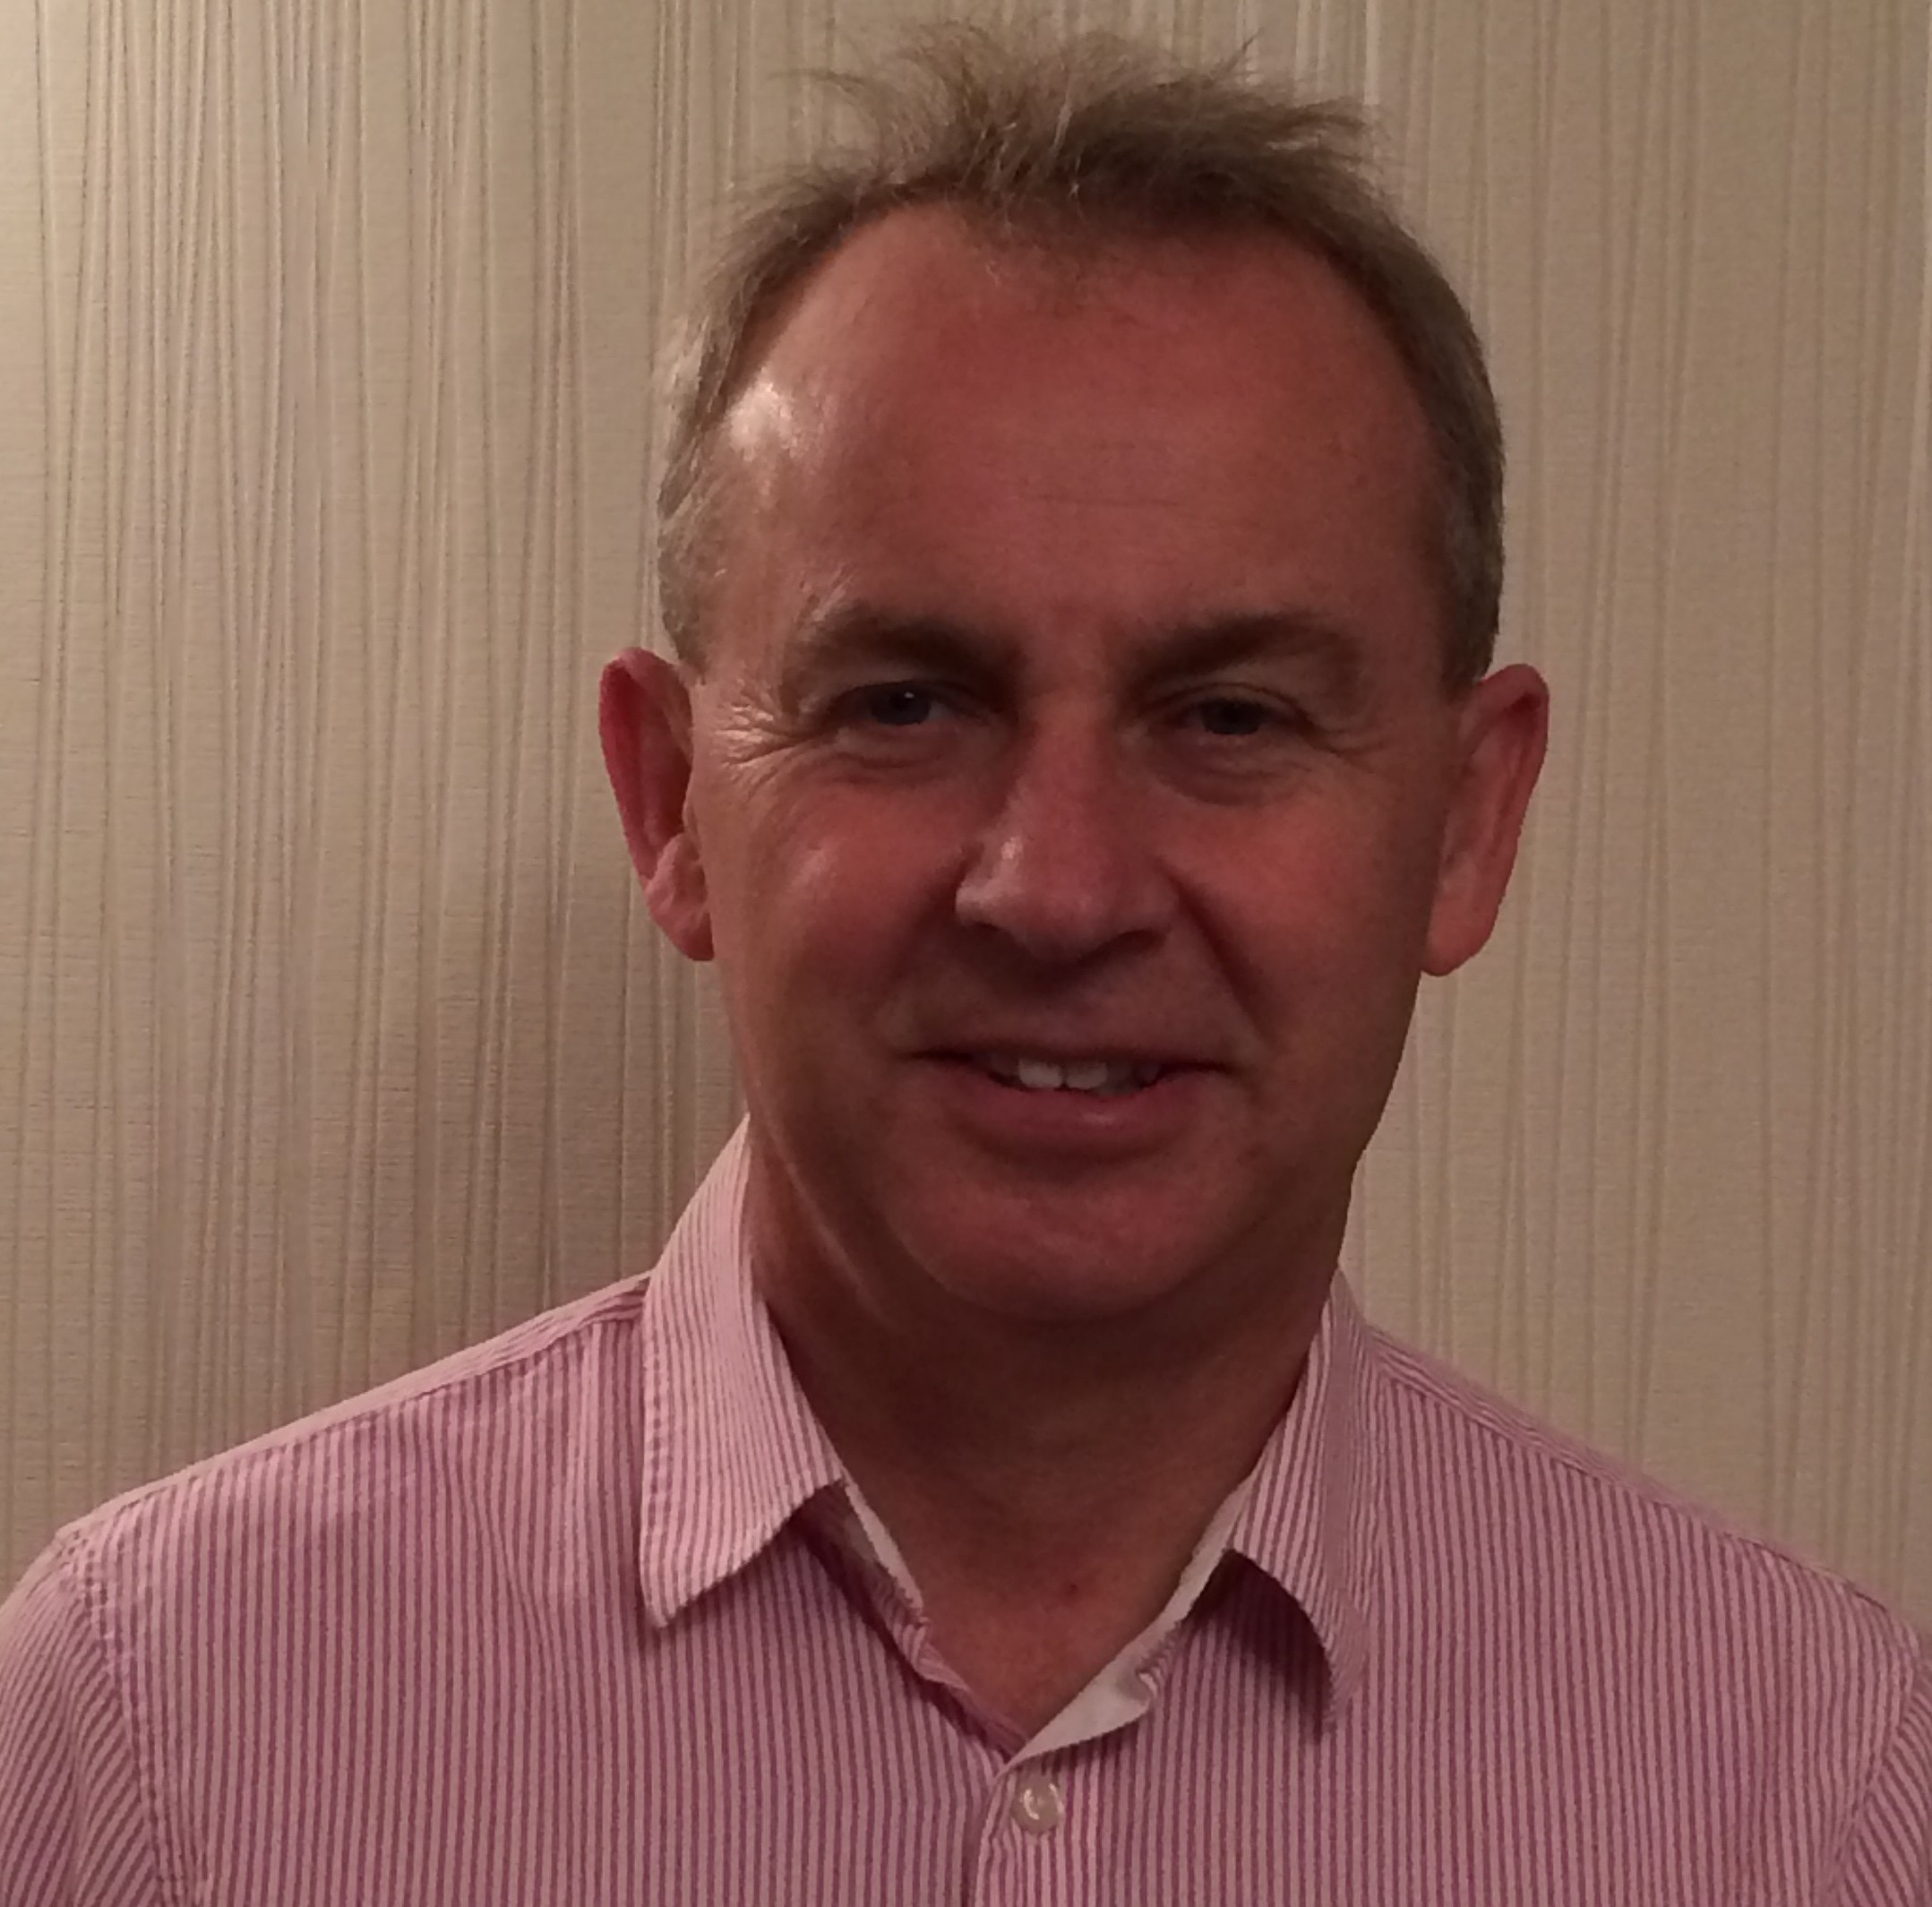
Asda
Chris Batt
Senior Manager Utilities
Energy Procurement – including the negotiation of energy & industrial gas contracts .
Hedging of fuels including diesel & LNG
20 Years in power sector
19 years in European oil and gas procurement with bp
3 years Asda
For projects like the deployment of LNG Asda brings together a cross functional team including Logistics, Procurement (energy & vehicle sourcing), Estates, Legal & Finance.
2
Notes:
Qs:
% time across each bubble

Slide 3
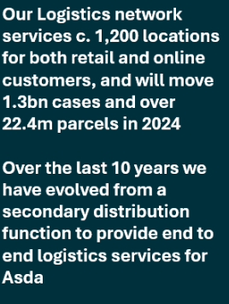
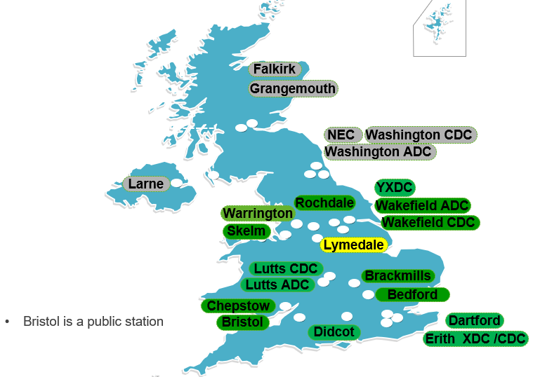
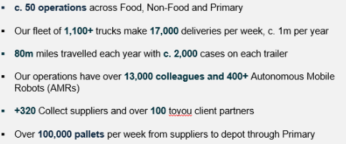
LNG Rollout Across the UK Depots
Key
Green = LNG Yellow = CNG Grey = Diesel
1
Notes:
More info £5m challenge ideas.xlsx & Utilities 2026 Savings Plan.xlsx

Slide 4
LNG Project Considerations
Just undertaken what was probably the largest tender for LNG supply within Europe with 50% of our stations / volume up for contract renewal.
What station technology / setup meets your requirements?
What do you actually need in the way of redundancy to support your operation?
Supply chain – fuel transport arrangements from Isle of Grain.
Can you build in any diversification of supply?
Gas conditioning – throughput of gas / control of condition?
Maintenance & Fault support? (Downtime to a minimum)
Ability to manage costs via fuel hedging?
3
Notes:
Grant (SM) & Phil (c10)

Slide 5
Supporting Technology
We like to be consistent in our approach:
We don’t want multiple systems
We want to rationalise systems and interfaces with other supporting software – e.g. Jigsaw
we try and integrate different platforms into each other through api etc
Digitalisation is important, we need to remove paperwork but must be replaced with simple user friendly systems
Too many systems lead to complication and the OEM’s natural starting point is to always want to use their own
Technology should simplify or improve G&S and save money.
3
Notes:
Grant (SM) & Phil (c10)

Slide 6
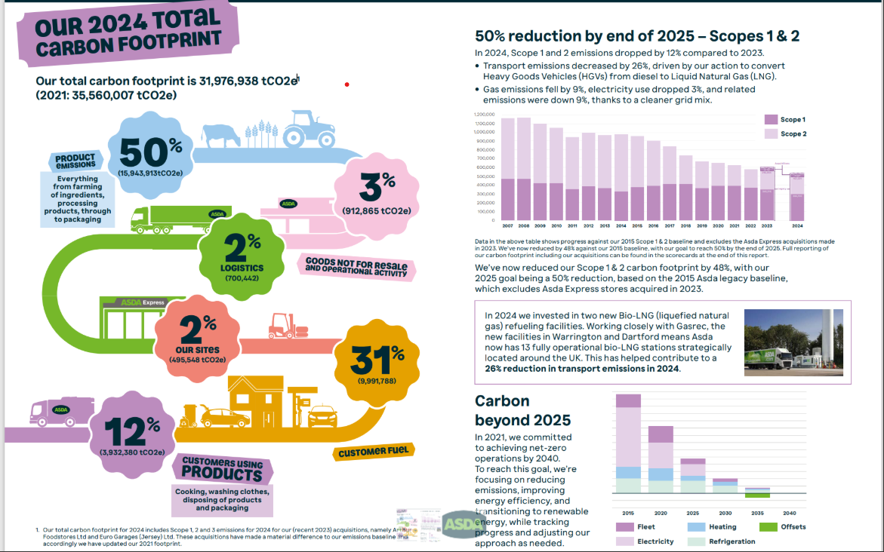
ESG Story - C15% reduction with non bio and up to 85% if bio (RTFC’s)

Slide 7
Actually efficiency (mpg equivalent) is ok (not better). OEM have made a good vehicle that drivers like to drive.
LNG Experience
ESG impact (with RTFC’s) has been a major contributor to meeting our targets up until 2024.
Efficiency (mpg equivalent) competitive with diesel
OEM have made a good vehicle that drivers like to drive.
The supply of LNG has been robust.
The uptime of stations have been very good.
The development of more public stations is helping to strengthen the robustness of fuel supply.
Fuelling does take slightly longer.
Economics do fluctuate depending on UK Natural Gas prices.
Good stepping stone to ZEV… battery and hydrogen still in their infancy.
3
Notes:
Grant (SM) & Phil (c10)

