Slide 1
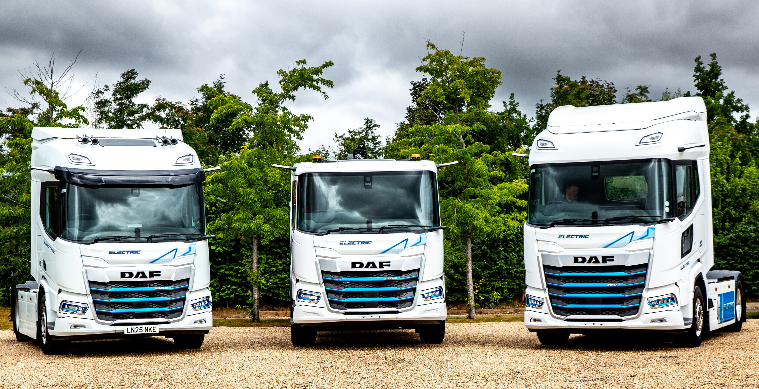

Slide 2

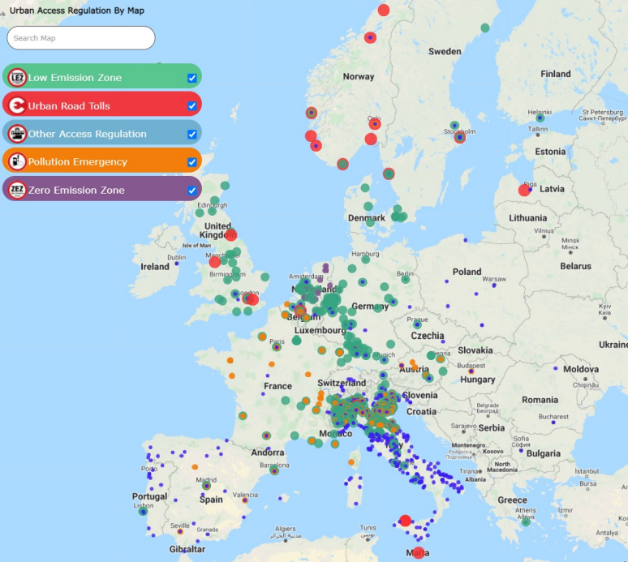

Zero emission market drivers
CO₂ Reduction | Urban Access Regulations | Corporate Sustainability
Notes:
75000 evs registered in china = to europe

Slide 3
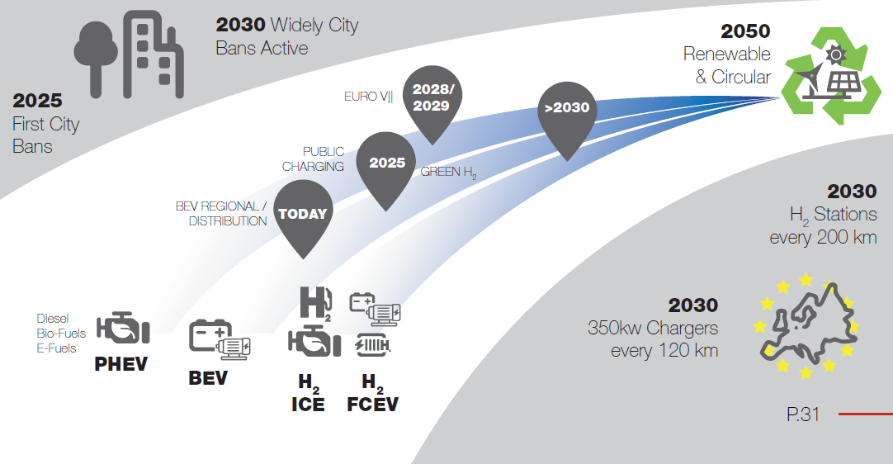
Notes:
To achieve a circular economy and net-zero emissions by 2050, a combination of strategies is required. Here’s our pathway that focuses on the use of hybrids, electric trucks, and hydrogen:
PHEV - Plug in Hybrid Electric Vehicles can be an initial step towards reducing emissions and fuel consumption. Hybrid trucks combine an internal combustion engine with an electric motor and battery system. This technology allows for regenerative braking, which charges the batteries during deceleration and improves fuel efficiency.
BEV – Battery Electric Vehicles are already in our portfolio. We expect the percentage of these trucks to grow significantly in the coming years but are depending on infrastructure and legislation to determine the speed of introduction. We expect BEVs to take over most of the short distance transports like city distribution, waste collecting, supply of supermarkets, etc.
Hydrogen can be used in a truck using 2 different techniques: ICE - Hydrogen Internal Combustion Engines and FCEV - Fuel Cell Electric Vehicles Technology. We are investing in research and development of both techniques to improve the efficiency and affordability of hydrogen as a fuel for heavy duty trucks.
Until now we expect we need a combination of these techniques to achieve our ambition to be circular and use renewable energy in 2050. In this journey the Circular Economy Approach will be used by
Focus on recyclability, modularity, and durability.
Promote recycling and remanufacturing practices for truck components and materials.
Work with our suppliers on circular supply

Slide 4








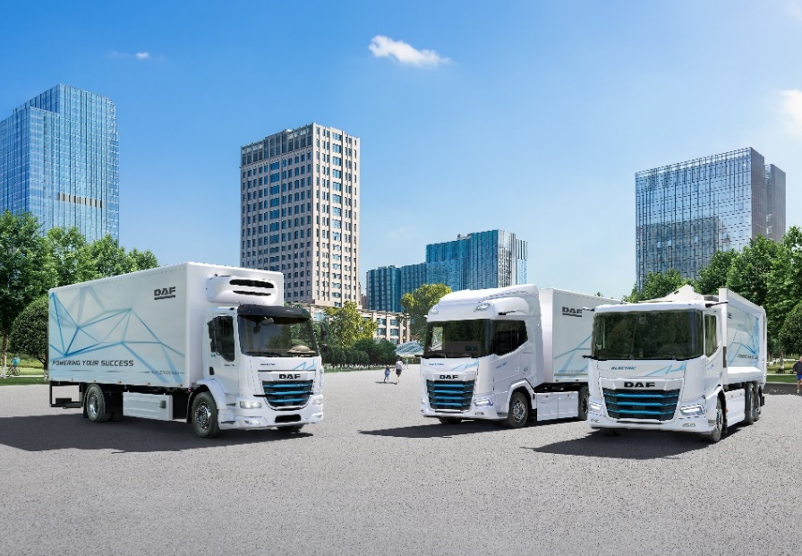
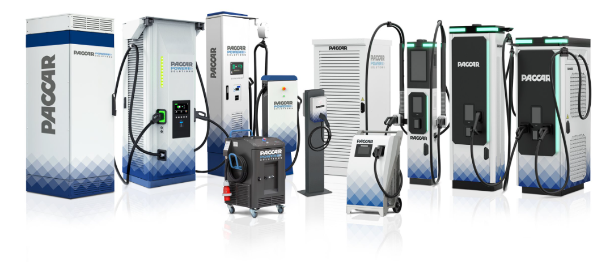
TOTAL TRANSPORT SOLUTION
Electric Vehicles | Charging Solutions | Services
Connected Services
Uptime Services
Financial Services
Fleet Services
Driver Training

Slide 5
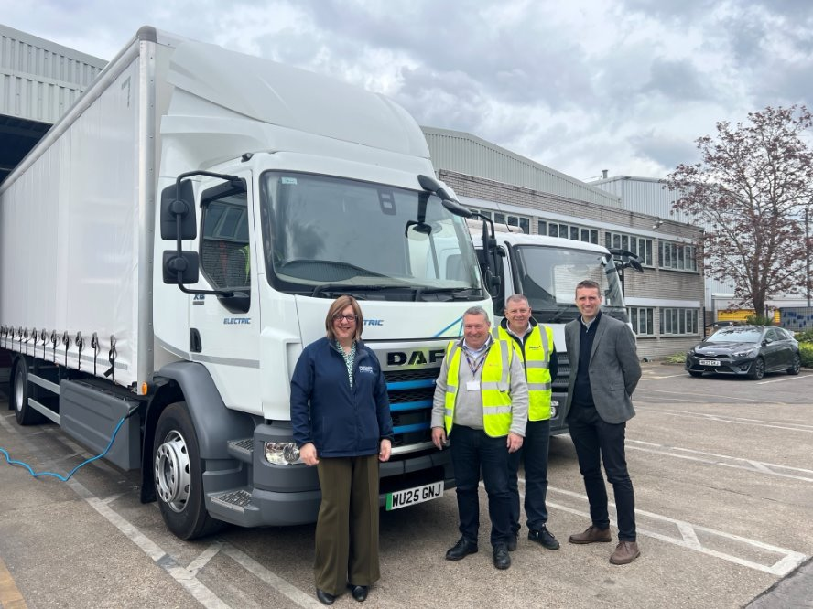
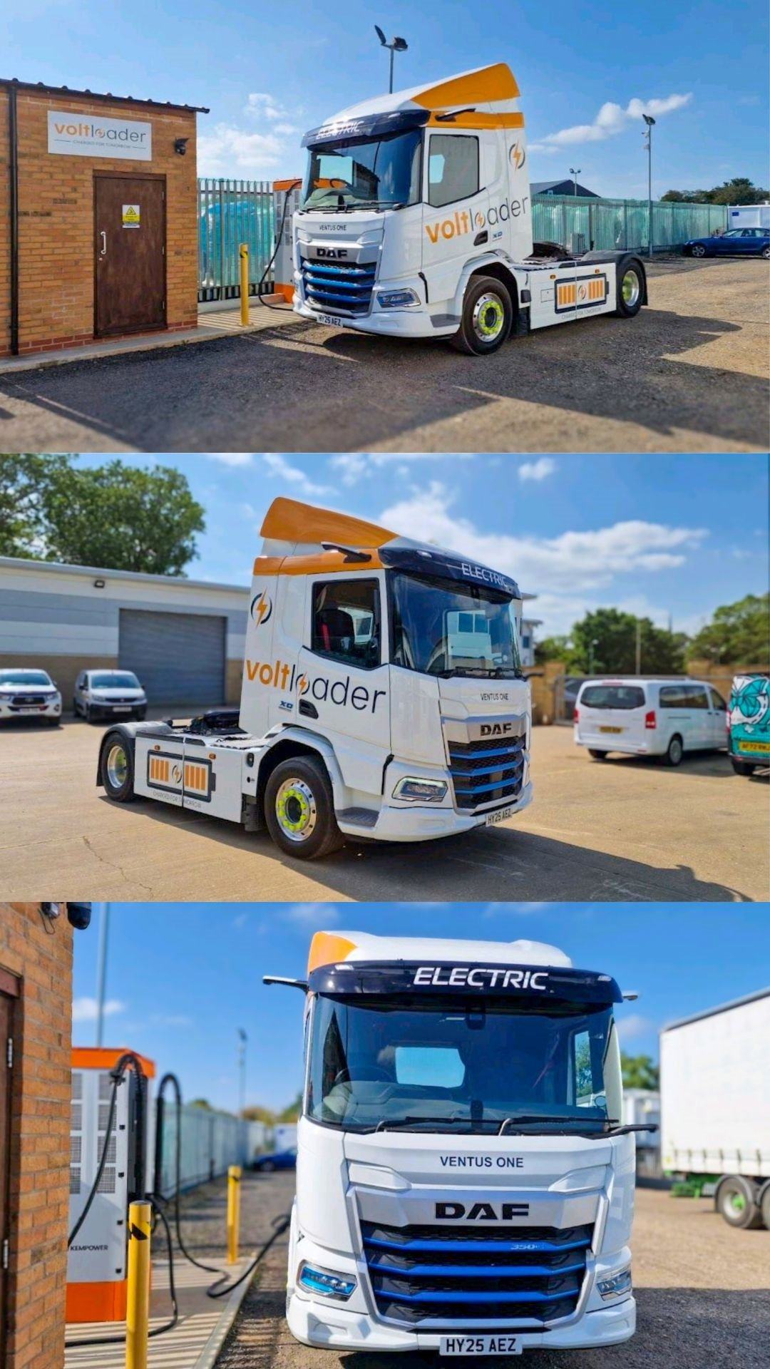
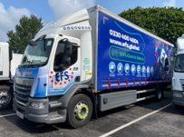
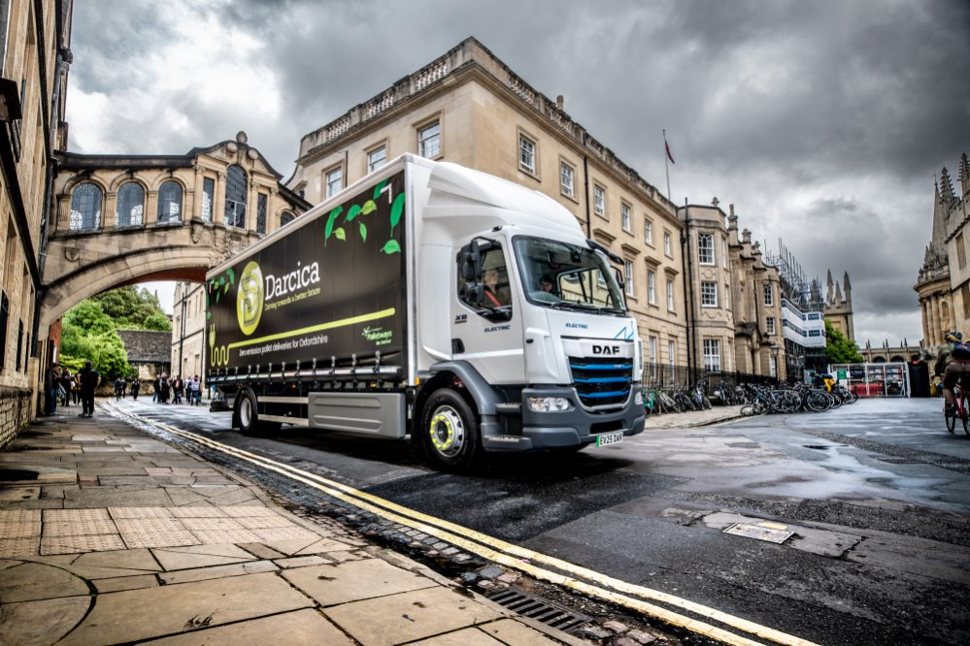
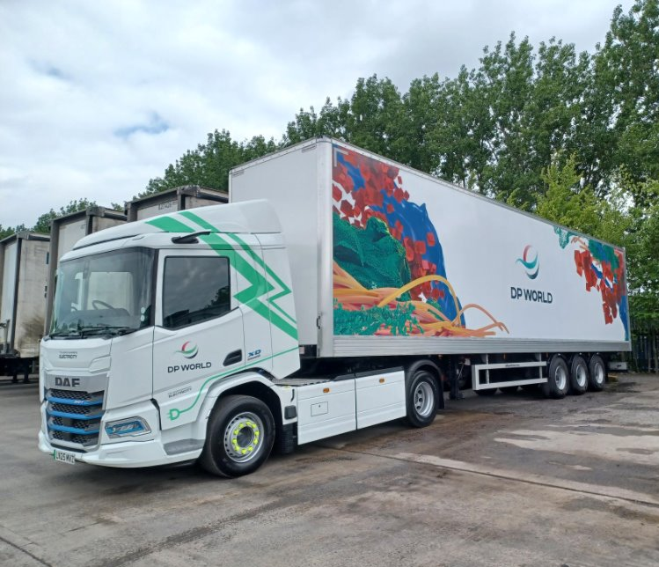
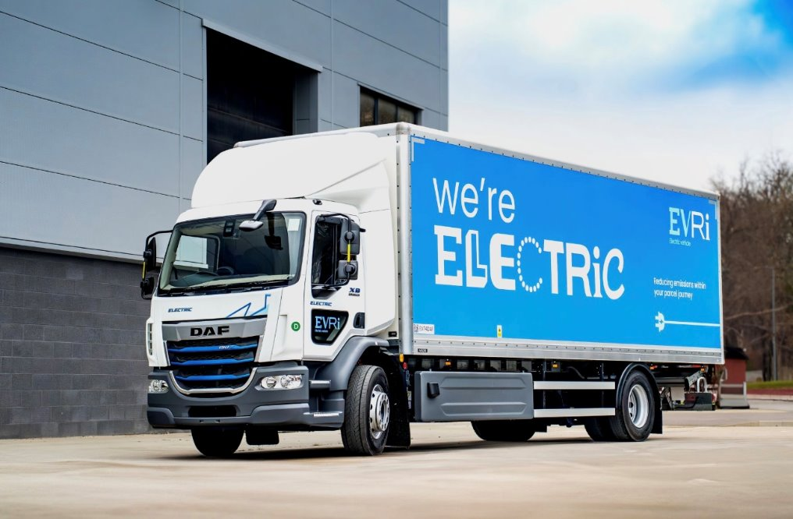
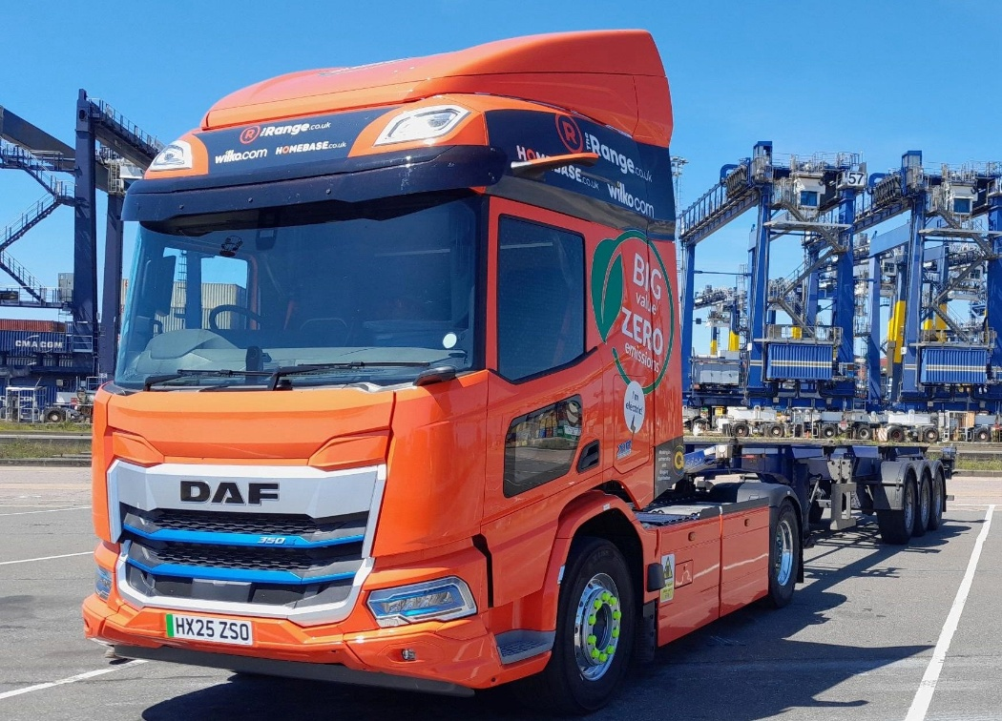
100+ VEHICLES ENTERING SERVICE 2025
Notes:
Great start – You are going to be the ones who make this happen – Today is when you will find out how.

Slide 6
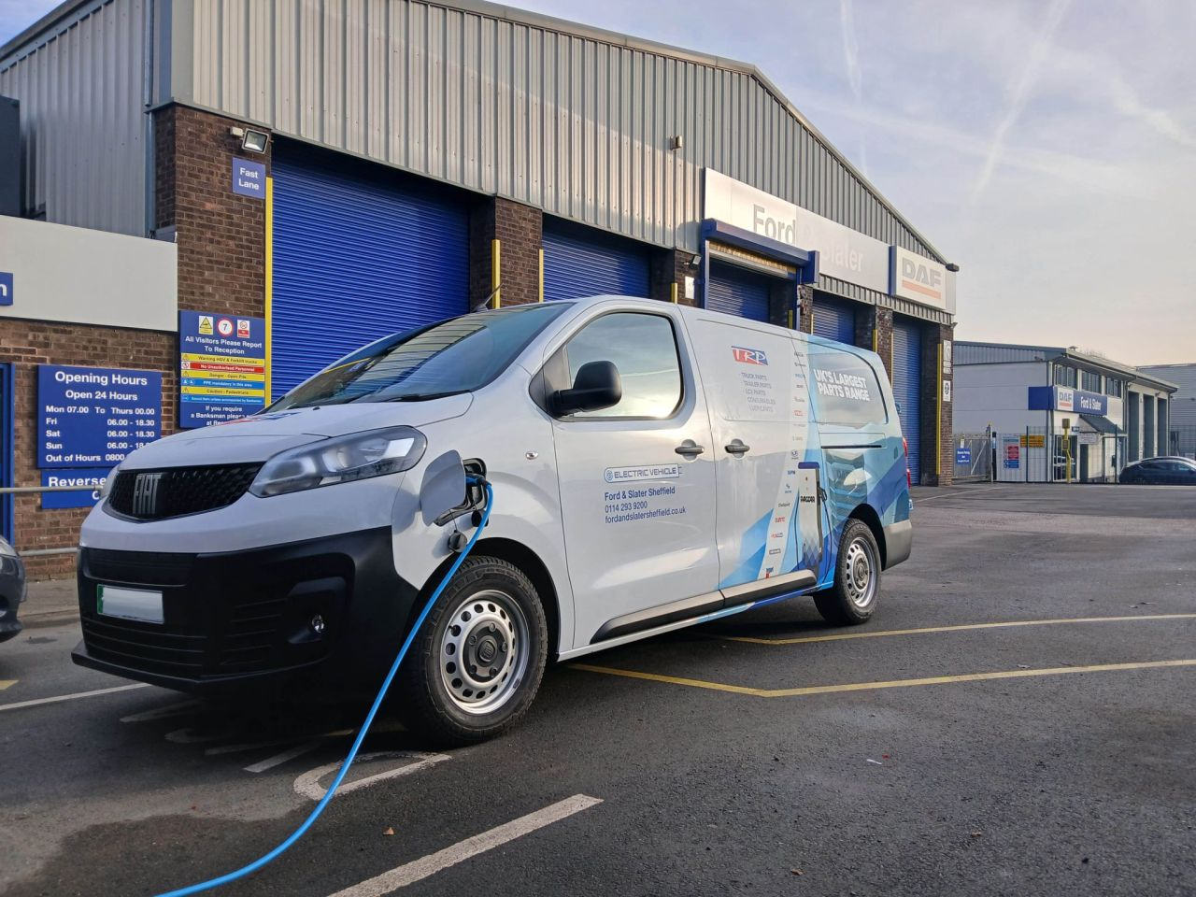
OWN FLEET ELECTRIFICATION
33% parts vans already EV
Over 90% company car replacements now EV
First 10 EV courtesy vehicles
ICE (incl PHEV) only by exception now

Slide 7
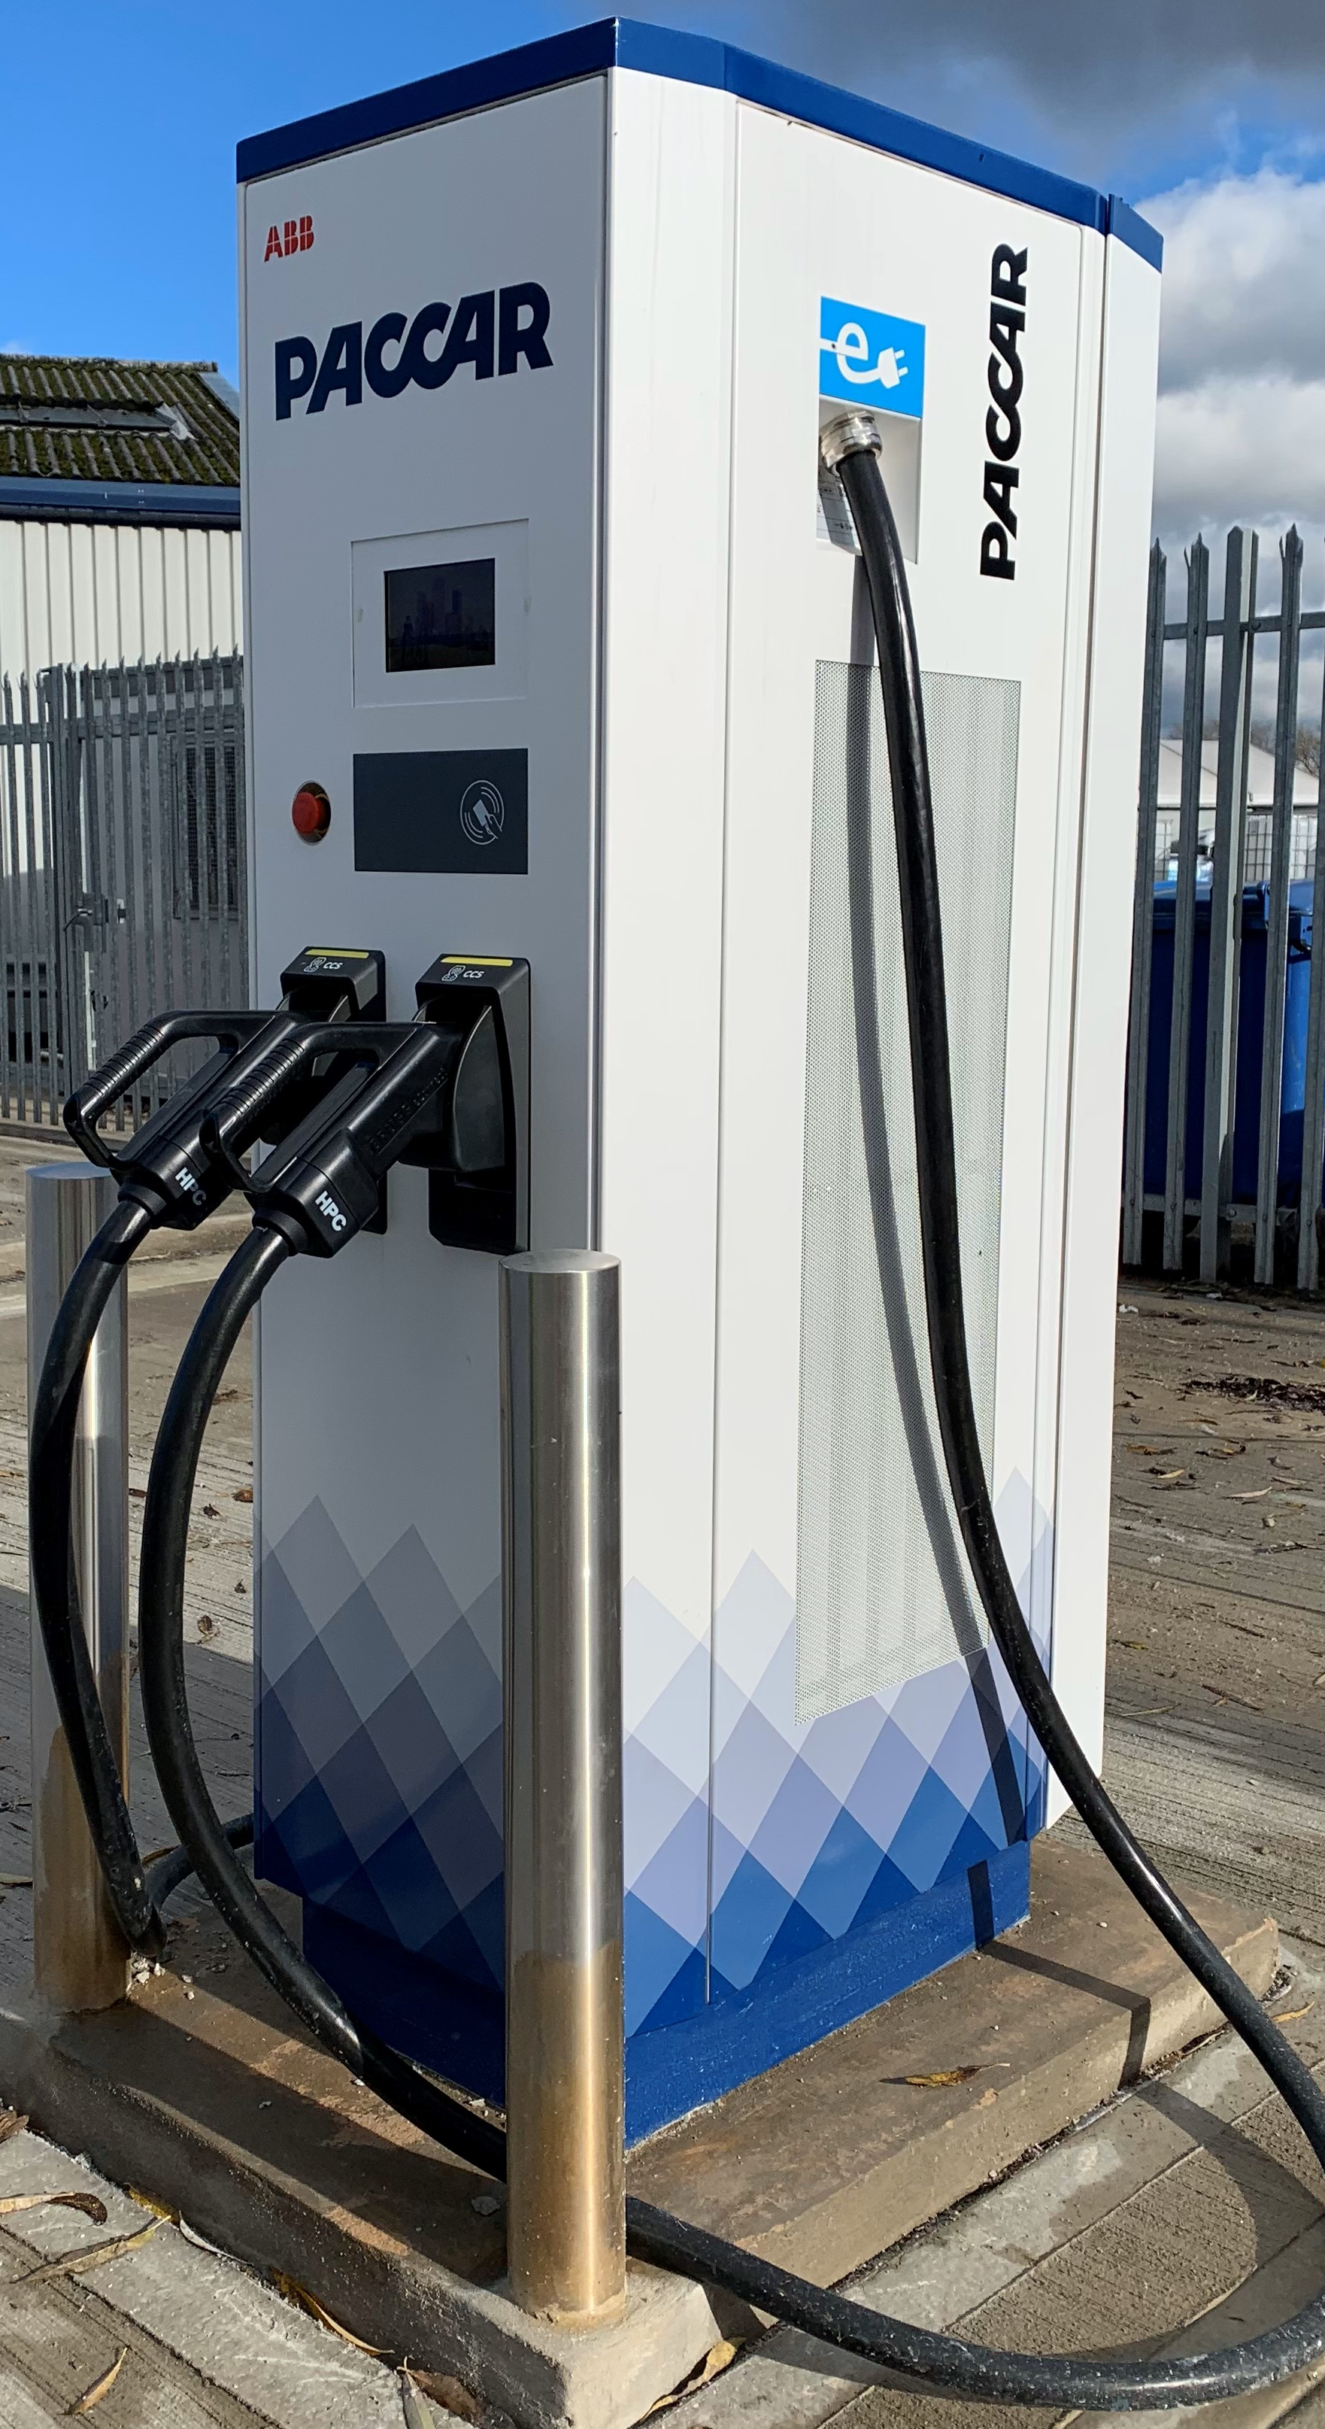
DEALER DC CHARGING NATIONWIDE
180 kW chargers in key locations
Charge-at-service and opportunity charge
Customer demand based install strategy
Pilot project supplier awarded for eMSP
Business model for charge at service

Slide 8
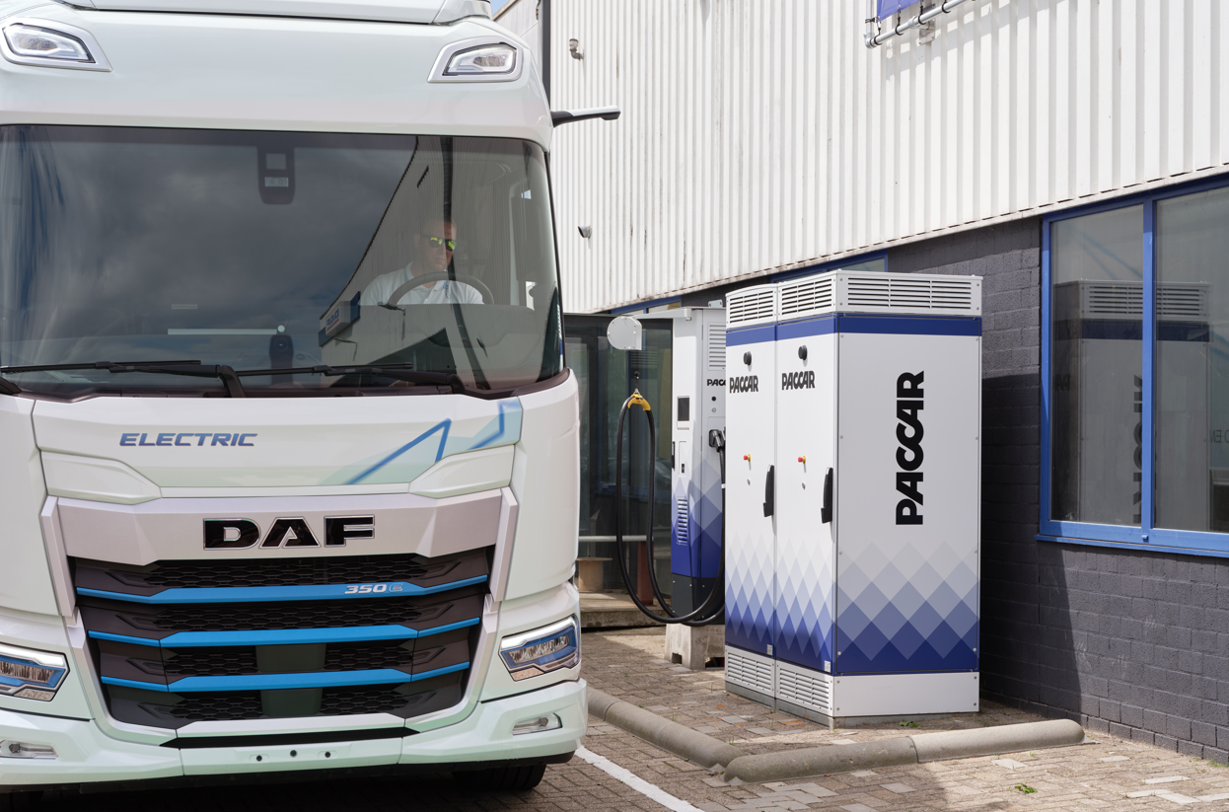
DEALER OF THE FUTURE
New business model opportunities
Charge at service
Charger maintenance
On route charging
Continued fleet and facilities decarb
813k people employed in automotive dealerships in the UK* (SMMT, includes supply chain)

